Slide 1
World War I
APUSH

Slide 2
The War “over here”
To win over there, the US had to mobilize over here
Wilson consolidated federal authority to organize US war production and distribution
Wilson began massive propaganda campaign aimed at winning American support for the war

Slide 3
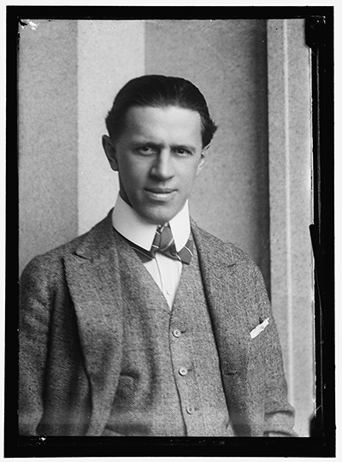
Homefront propaganda
WIlson formed the committee on public information (CPI) and hired muckraker George creel to publicize the US war effort
Voluntary censorship in press
Propaganda in motion picture films
LED TO SWEEPING ANTI-GERMAN SENTIMENT
Bach, Beethoven, & Brahms were not played in symphonies
Sauerkraut renamed “Liberty Cabbage” and pretzels no longer served in bars

Slide 4
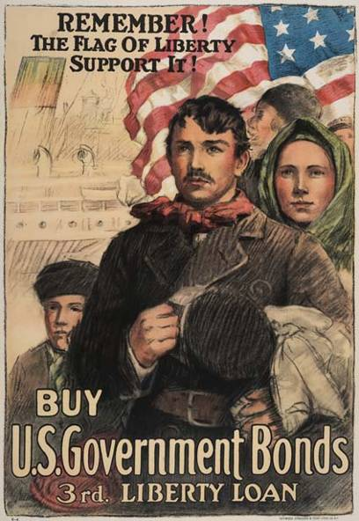
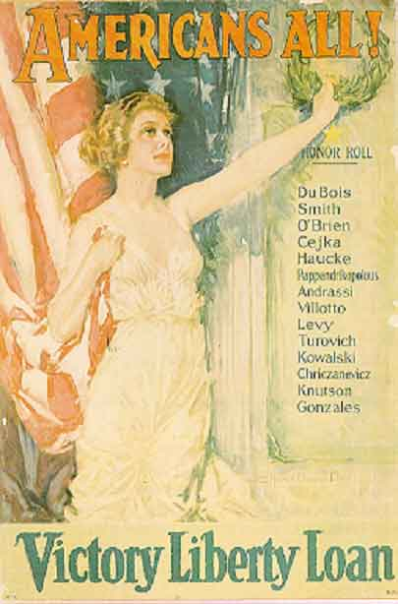
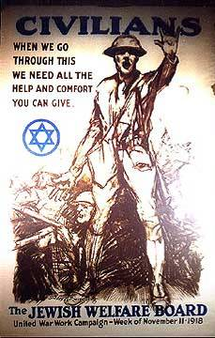

Slide 5
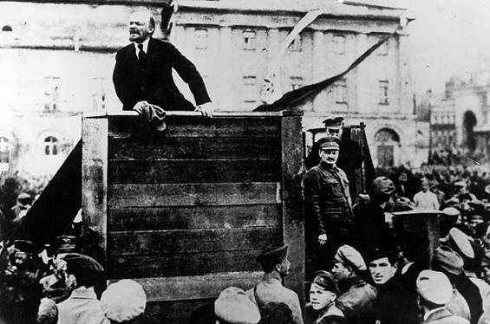
Red scare
Nov 1917- Vladimir Lenin and Bolsheviks overthrow Russian government and established USSR, 1st communist nation
Russia pulled out of WWI
Americans angry about Russian pull-out on Eastern front
Wilson sent troops to USSR, but refused to recognizer new government
Nov 1917- Vladimir Lenin and Bolsheviks overthrow Russian government and established USSR, 1st communist nation
Americans feared the spread of Communism into US
Eugene Debs- Formed Socialist Party
Encouraged strikes
Every strike fueled fears of Bolshevik-style socialist revolution in America

Slide 6
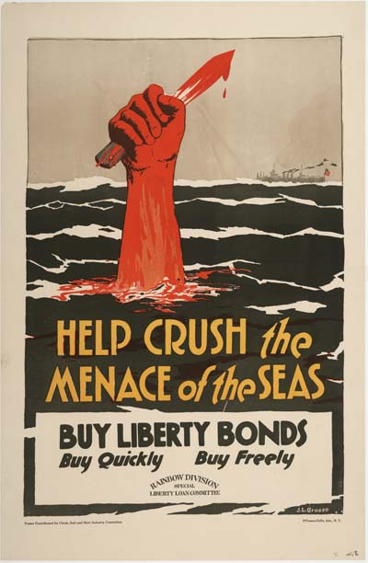
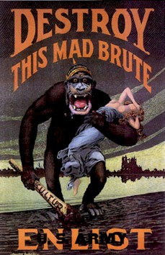
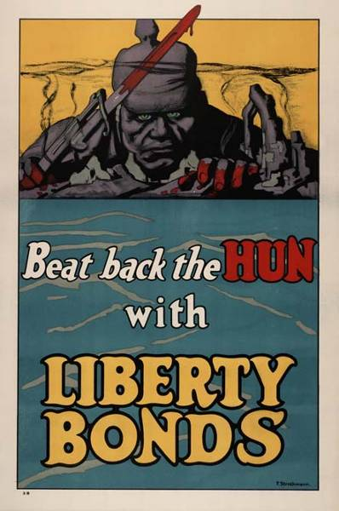

Slide 7
Homefront censorship
Wilson encouraged censorship
Espionage Act: aiding enemy, obstructing troop recruitment, or encouraging disloyalty illegal
Sedition Act: made it illegal to speak “disloyally” towards the US govt., flag, or troops
Restrictions on 1st amendment upheld by courts (3 major cases)
Schenk v. US
Debs v. US
Abrams v. US
First amendment can be restricted when it presents a “clear and present danger”
All supported convictions under Espionage Act of 1917

Slide 8
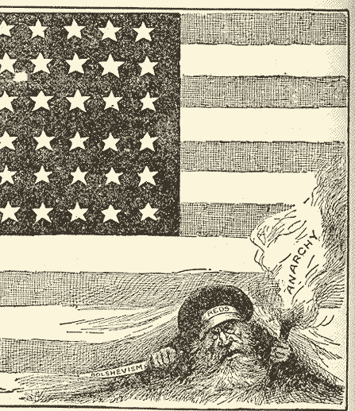
Red Scare
“Put Them Out & Keep Them Out” Philadelphia Inquirer

Slide 9
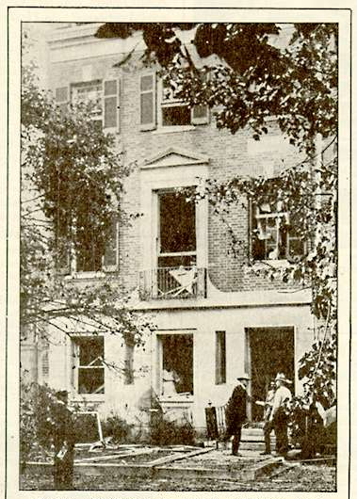
Red Scare
US attorney general Mitchell palmer
Used bombing of own house to pass Alien Act of 1918
Arrested or deported ~6,000 suspected radicals (many innocent)
“Palmer Raids”

Slide 10
A bureaucratic war
5,000 new government agencies created to coordinate war effort
War Industries Board (WIB): Oversaw all factories, determined priorities, fixed consumer prices
Food Administration: supplied food to soldiers by appealing to civilians
Asked for spirit of self-sacrifice: “meatless” and “wheatless” days and encouraged “Victory gardens”
Fuel Administration
Imposed “Gasless” days and shut down factories for days to conserve fuel
RR Administration, War Shipping Board, War Trade Board
Helped moved resources to troops
War expensive: $32 billion- paid for by
Liberty Bonds (raised $23 billion)
Boost in personal and corporate income taxes (led to $10 billion)

Slide 11
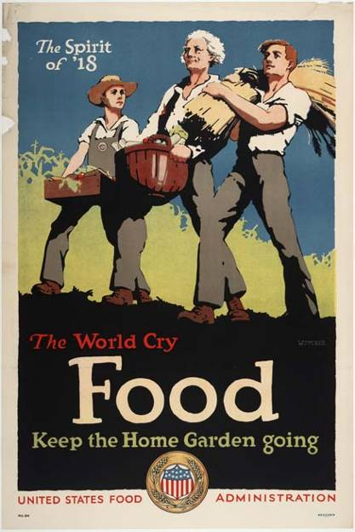
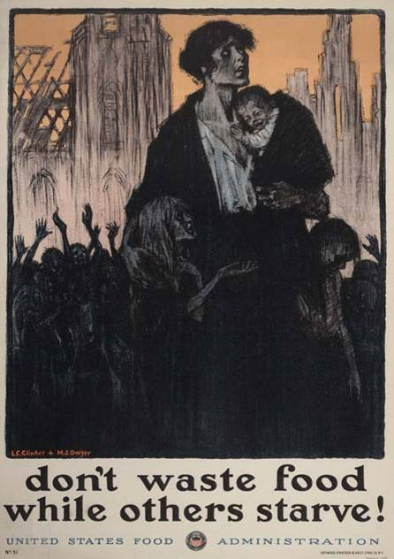
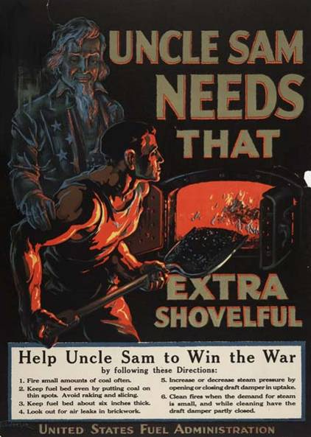

Slide 12
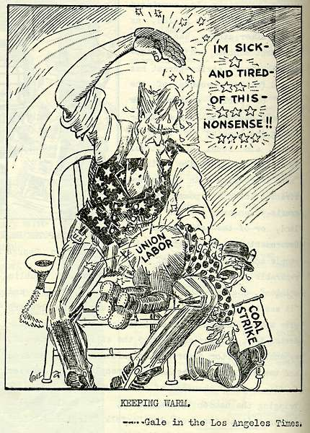
Workers in war
WWI led to new alliance between govt. and labor unions
War Labor Board (WLB): formed to standardize wages and hours, protect union rights, and give equal pay to women
WLB seized companies during strikes (national interests come first!)
Coal Miners Strike:1919

Slide 13
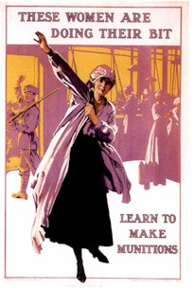
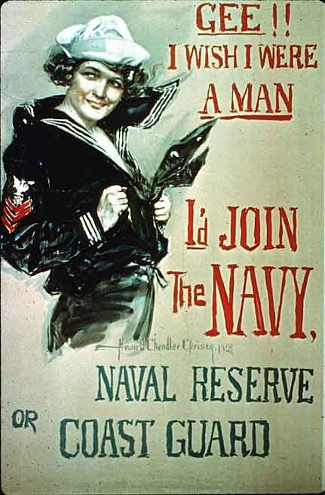
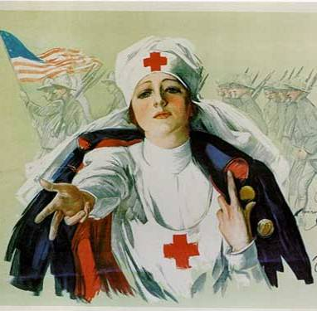
Workers in war
War called for more laborers:
8 million women workers
New, better paying jobs in industry
Helped to recruit and sell war bonds
Joined the Red Cross
450,000 Southern blacks
Moved north for new industrial jobs and better pay
Led to race riots
100,000 Mexican laborers
Worked on SW farms and ranches

Slide 14
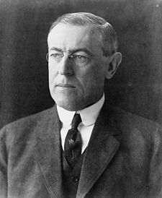
Wilson’s Fourteen Points
Plan for peace created by Wilson in Jan 1918 – before the end of the war
Given in a speech before Congress
Task: You were asked to read Wilson’s speech. With a partner, complete the chart, determining which issue the points were meant to address

Slide 15
Wilson’s Fourteen Points
Plan created by Wilson in Jan 1918 – before the end of the war
#’s 1-5 “Wilsonian Ideals”
How to prevent another war
#’s 6-13 “Self Determination”
Boundary changes
#14 – League of Nations
An international organization to address diplomatic crises

Slide 16
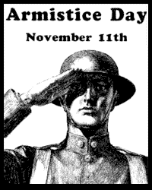
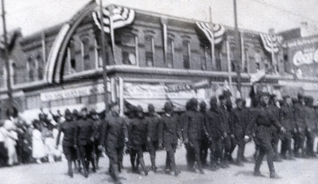
The War Ends
November 1918
Austria Hungary surrenders 11/3
Germany facing multiple problems
Left alone without any allies
Cease-fire agreed to on 11/11 @ 11am

Slide 17
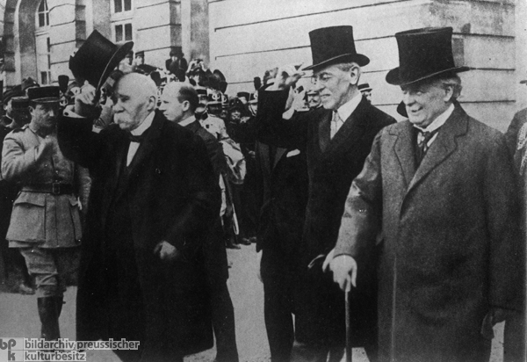
Paris Peace Conference
Leaders of US, France, Britain, Italy
Guess who’s not invited?
Germany
Austria Hungary
Russia
Do you think this is fair?
Georges Clemenceau (France)
Woodrow Wilson (U.S)
David Lloyd George (Britain)

Slide 18
Treaty of Versailles
Activity:
- Using the chart, determine what decisions you would make in creating a treaty ending WWI

Slide 19
Terms for Germany
WAR GUILT CLAUSE
Germany had to accept blame for starting WW1
GERMANY’S MILITARY FORCES REDUCED
NO UNION WITH AUSTRIA
- Army restricted to 100,000 men.
- No modern weapons such as tanks, military air force.
- Navy could not have battle ships over 10,000 tons and no U-Boats.
REPARATIONS
THE TERMS
OF THE TREATY OF
VERSAILLES
1919
Germany required to pay massive fine for war damages - $5 Billion within 2 years ($28 Billion all-together)
GERMAN OVERSEAS TERRITORRIES
Germany lost Chinese ports [Amoy and Tsingtao], Pacific Islands, and African colonies [Tanganika and German SW Africa].
RHINELAND TO BE DE-MILITARIZED
GERMAN TERRITORY IN EUROPE
Germany lost national territory which was given to Belgium and Denmark, most went to Poland.

Slide 20
League of Nations (1919-1947)
What?
First permanent international security organization whose principle mission was to maintain world peace
Prevent war through: disarmament
Settle international disputes: negotiation and arbitration
Precursor to the United Nations
Even though it was Wilson’s Idea, the US NEVER joins
Senate refuses to ratify treaty of Versailles because of League of Nations

Slide 21
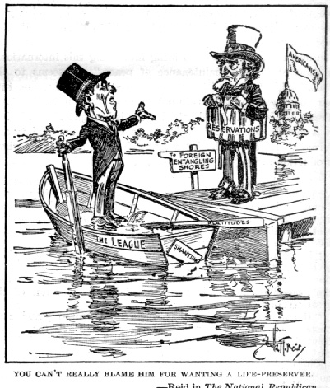
Rejection in the senate
2/3 of senate was needed for us to approve treaty:
Mild reservationists: wanted changes to slightly weaken league
Strong reservationists: led by Henry Cabot Lodge- wanted major changes to Article 10, which required member nations to protect each other when attacked
Irreconcilables: refused to allow the US to join the League of Nations

Slide 22
Rejection in the senate
Lodge (senate majority leader) led attack on treaty and league
Wilson attempted to pressure Senate by launching cross-country speaking tour
Tour was popular but ineffective in pressuring Lodge
Wilson suffered a massive stroke while on tour & became bed-ridden
Edith Wilson served as de facto president for the remainder of the term

Slide 23
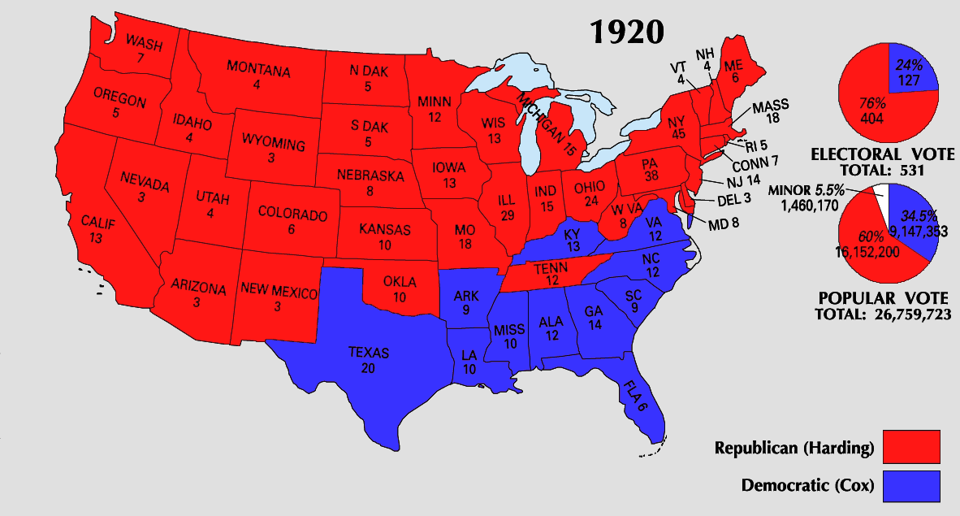
Warren g harding won landslide victory in 1920- promising a “return to normalcy”

