Slide 1
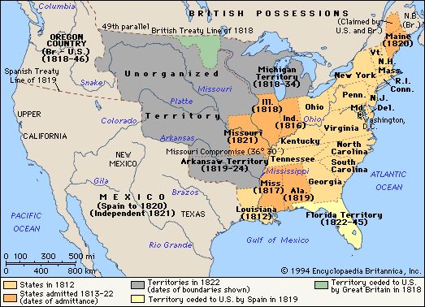
The Election of 1824 and the J.Q Adams Presidency

Slide 2
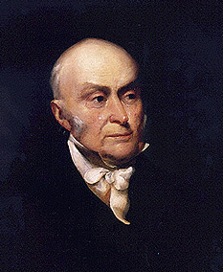
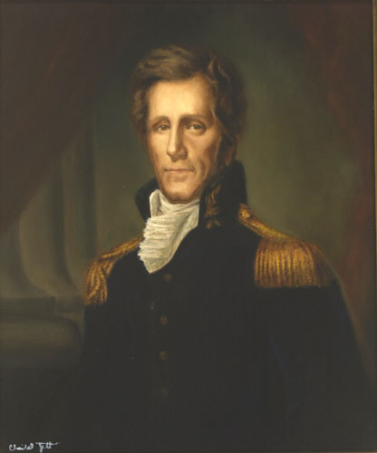
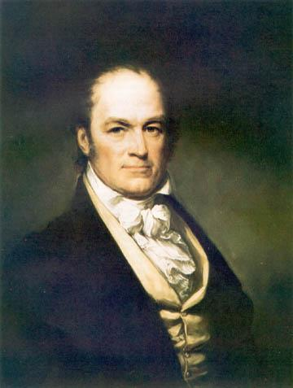
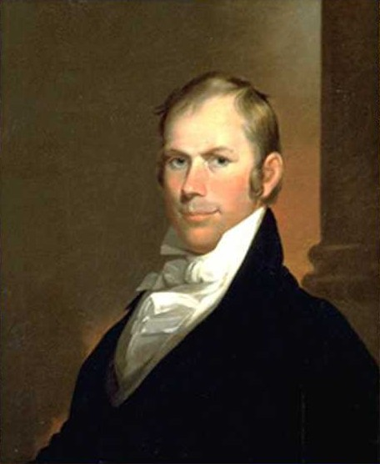
John Quincy Adams
Son of Abigail and John Adams
Harvard University
Intelligent and high morals
Seemed hard and cold
Andrew Jackson
“Hero of New Orleans”
In the War of 1812
“Old Hickory”
Man of the people
Election of 1824
William H. Crawford
Farmer, school teacher, lawyer
Secretary of War (Madison)
Henry Clay
Speaker of the House of Representatives

Slide 3
John Quincy Adams
Democratic-Republican
Massachusetts
30.9%
84
Andrew Jackson
Democratic-Republican
Tennessee
41.3%
99
Won plurality but not majority
Winner
Electoral College
Election of 1824
Popular Vote
Election of 1824
William H. Crawford
Democratic-Republican
Georgia
11.2%
41
Henry Clay
Democratic-Republican
Kentucky
13.0%
37

Slide 4
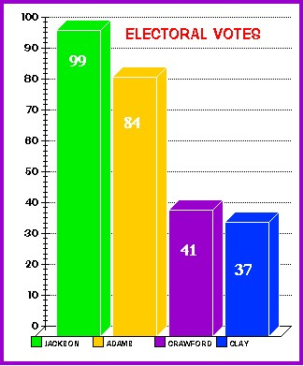
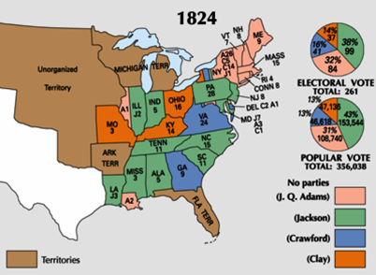
Andrew Jackson received the most popular votes in the 1824 election but not a majority of the electoral votes.
The election would be decided in the House of Representatives

Slide 5
John Quincy Adams
William H. Crawford
Andrew Jackson
According to the 12th Amendment, if one candidate does not receive the majority of the electoral votes, the House had to decide between the top three candidates. Henry Clay was out of the running, but…..
as Speaker of the House he was able to influence the results.
Henry Clay
Speaker of the House

Slide 6
“There was cheating and corruption and bribery, too!”
Winner!!
John Quincy Adams
William H. Crawford
Andrew Jackson
“I cannot believe that killing 2,500 Englishmen at New Orleans qualifies for the various, difficult, and complicated duties of the Chief Magistracy.”
Corrupt Bargain
House Vote
Adams 13
Jackson 7
Crawford 4
Henry Clay
Clay hated Jackson.
Clay urged members of the House to vote for Adams.
Jackson was shocked because he was the winner of the plurality of both the popular and electoral votes.
Once Adams was named President he appointed Clay as Secretary of State.
Secretary of State

Slide 7
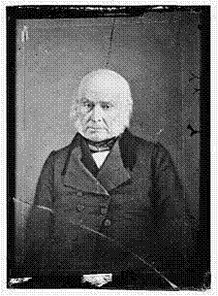
Adams took office in March 1825 but the election had angered many Americans and this seriously hampered President Adams’s efforts to unify the nation.
Until the 2000 election John Adams and John Quincy Adams were the only father and son to both serve as President.
He made time nearly every day to skinny-dip in the Potomac River
The only President to be elected to the House of Representatives after his Presidency. (Massachusetts)
First President to be photographed, although it was taken after he was out of office.

Slide 8
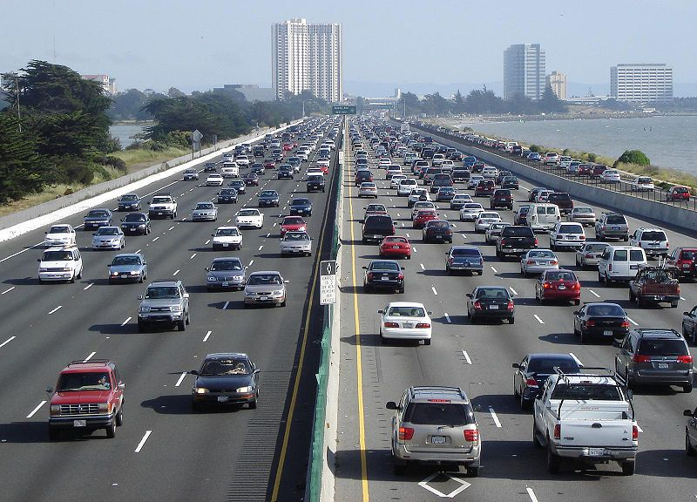
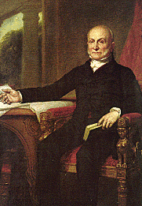
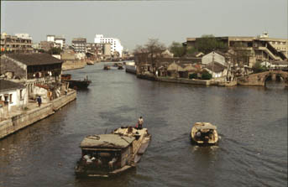
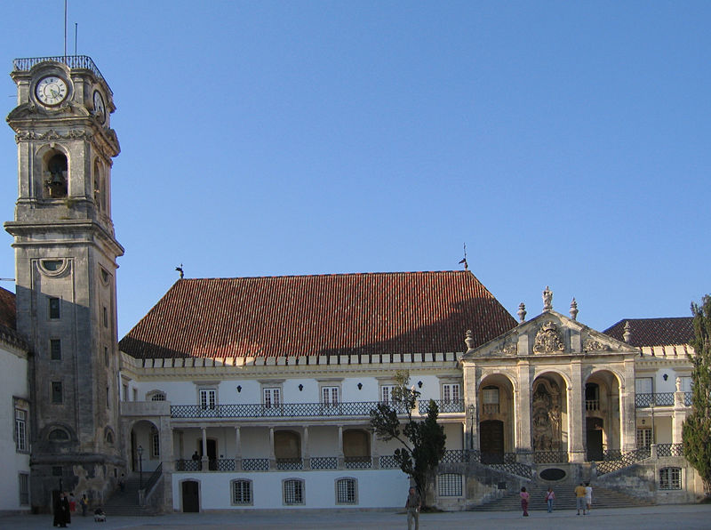
Adams’ Goal:
Adams thought that the federal government should promote economic growth.
This would help farmers to transport goods to market
Economic Plan
called for the government to pay for new roads and canals
promote the arts and the sciences by building a national university and observatory from which astronomers could study the stars

Slide 9
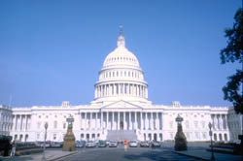
Most Americans objected to spending money on such programs. They feared that the federal government would become too powerful.
Congress approved money for a national road and some canals but turned down most of Adams’ other programs.

Slide 10
Election of 1828
New political party
The Democratic-Republicans split between those who supported :
Jackson - Democratic Republican
Adams - National Republicans
Jackson is dangerous! He will become a dictator like Napoleon!
Adams is an aristocrat! Remember the “corrupt bargain!”
John Quincy Adams
Andrew Jackson
National Republicans
Democratic-Republican

Slide 11
WINNER!

