Slide 1
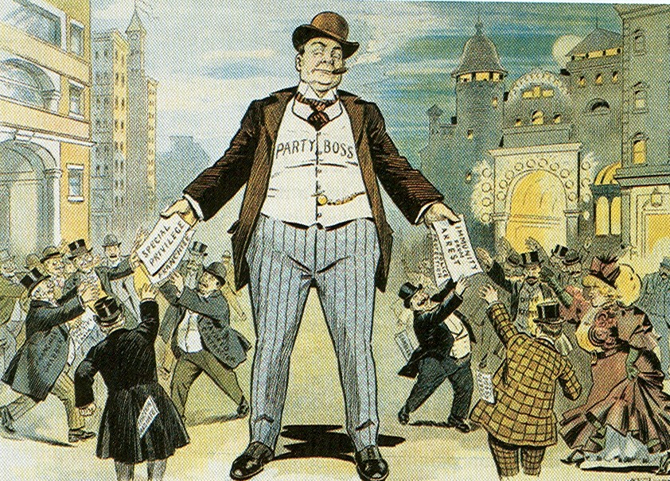
National Politics In The Gilded Age, 1877-1900

Slide 2
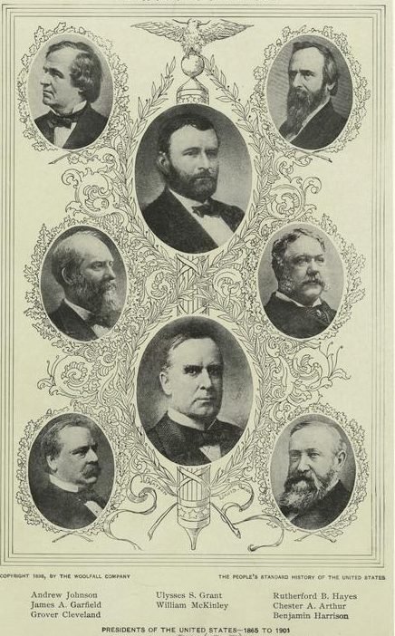
Presidents of the Gilded Age
The phrase “Gilded Age” means to be covered with gold; Depicted an American society that on the surface appeared prosperous and full of opportunities but underneath was corrupt and scandalous.
Ulysses S. Grant (R) 1869-1877
Rutherford B. Hayes (R) 1877-1881
James A. Garfield (R) 1881
Chester A. Arthur (R) 1881-1885
Grover Cleveland (D) 1885-1889
Benjamin Harrison (R) 1889-1893
Grover Cleveland (D) 1893-1897
William McKinley (R) 1897-1901
2
Notes:
2

Slide 3
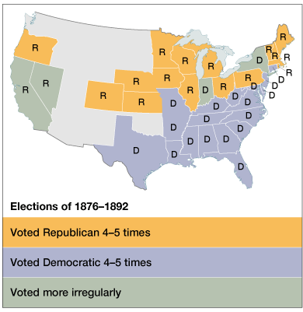
Politics in the Gilded Age, 1870’s to WW I
Main Political Issues
Civil Service Reform
Currency Standards
Tariff Legislation
Two Party Stalemate

Slide 4
The Two Party Stalemate
Congress Divided As Well
- Democrats controlled House
- Republicans held senate
“Stalemate” made it difficult for any president of time to pass significant legislation for 20+ years
- Pendleton Civil Service Act 1883
- Interstate Commerce Act 1887
- Sherman Anti-Trust Act 1890
- McKinley Tariff 1890
Presidential elections from 1876-1896 were the most closely contested in history
In 3 of the 6 elections, less than 1% of popular vote separated winner from loser

Slide 5
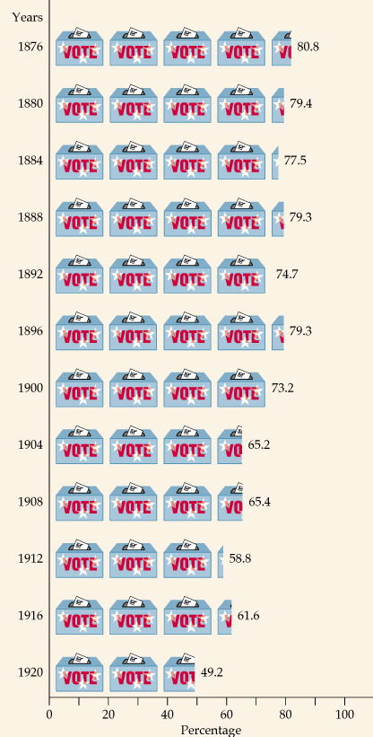
Voter Turnout and Political Machines
Very High Voter Turnout During Gilded Age Elections
Close to 80% in all presidential elections of the age
- Very few voter laws to prevent fraud, so people could vote multiple times
-Political Machines often paid immigrants to “vote early and vote often”
-Voters were very party loyal, which meant that regardless of the issue, they voted party
-”Voting in the Graveyard”- Political Machines cast votes in the name of deceased persons

Slide 6
Political Party Bases
Democratic Base
Republican Base
Supported by white southerners, farmers, immigrants, & the working poor
Favored white supremacy & supported labor unions
Supported by Northern whites, blacks, & nativists
Supported big business & favored anti-immigration laws

Slide 7
Civil Service Reform
Civil Service Reform Most Important Political Issue of 1880’s
Federal bureaucracy swelled in size after 1880
Department of Agriculture & Bureau of Indian Affairs added
(Meant More Jobs)
Positions were appointed by patronage
(Spoils System)
56,000 jobs filled by patronage in1881
Political machines ruled cities through bribes & personal favors
Treasury Department Grew from 4,000 employees in 1873 to 25,000 in 1900
Congressmen often took bribes or company stocks for their votes

Slide 8
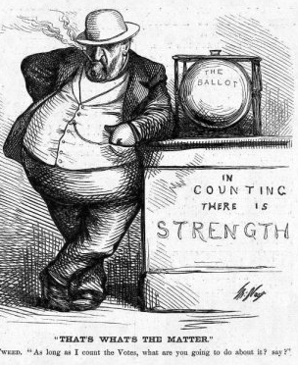
The “Bosses” of the Senate
Boss Tweed of the NYC Democratic Political Machine, Tammany Hall

Slide 9
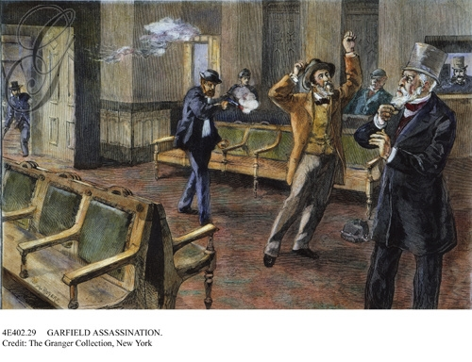
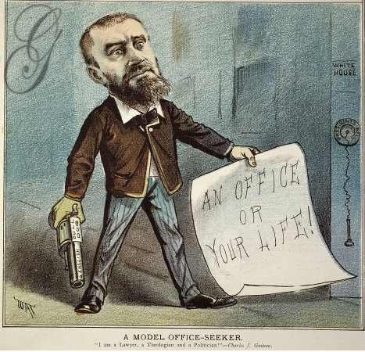
Civil Service Reform
Civil Service Reform received boost when unsuccessful patronage seeker, Charles Guiteau assassinated President Garfield
1883- Congress Created the Pendleton Civil Service Act to create merit based jobs and exams for civil service jobs
State and local governments mirrored these reforms in 1880’s and 1890’s

Slide 10
Government Regulation of Industry
From 1870 to 1900, 28 state commissions were created to regulate industry, especially railroads
Munn v. Illinois (1876)
1870- Illinois declared RR’s to be public highways, thus controlled by the state.
Supreme court case upheld decision
Wabash v. Illinois (1886)
Overturned Munn decision
Declared that “only Congress can regulate interstate trade”

Slide 11
Tariffs and Trusts
Congress responded to attempts to fight regulation
Interstate Commerce Commission- 1887:
- Purpose to regulate RR
- First attempt by federal government to regulate big business
- Became model for future regulatory agencies
Sherman Anti-trust Act 1890:
- Made it illegal to restrain trade (punishable by dissolution of the company
- U.S. v. EC Knight co (1895) First test of act
- Weakened by Supreme Court by ruling that this sugar monopoly does not restrain trade because making a good is not the same as selling it

Slide 12
Panic/Depression of 1893
Most serious blow to politics in the Gilded age was a five year depression that began in 1893
Philadelphia & Reading Railroad went bankrupt
- Set off a stock market panic
- 500 banks, 200 railroads, & 1,500 businesses failed
- Companies cut wages and laid off workers
- Unemployment hit 20%
What was blamed for this economic downturn?
Sherman Silver Purchase Act: Had backed money with gold or silver, which meant money was deflated.
McKinley Tariff: Protectionist that caused decline in American economy
Grover Cleveland and Democrats

Slide 13
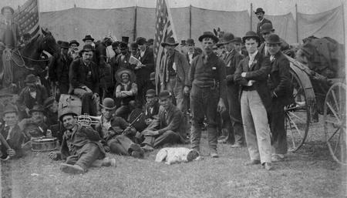
Coxey’s Army (1894)
In 1894, there were 4,000 strikes led by unemployed people demanding gov’t relief
- Jacob Coxey led an “army” from Ohio to D.C. to convince Congress to create jobs by spending $500 million on new roads
- This is the economic downturn that launched the Pullman strike

