Slide 1
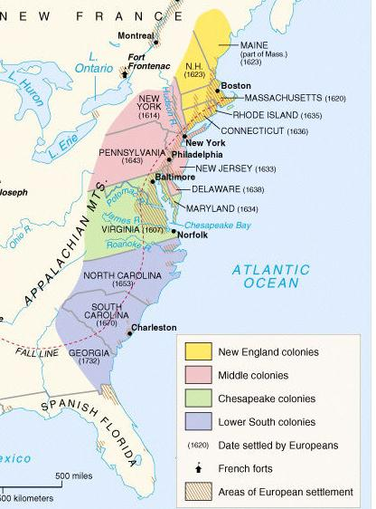
The Middle & Lower South Colonies
Notes:
Explain the development of the mid-Atlantic colonies; include the Dutch settlement of New Amsterdam and subsequent English takeover, and the settlement of Pennsylvania.

Slide 2
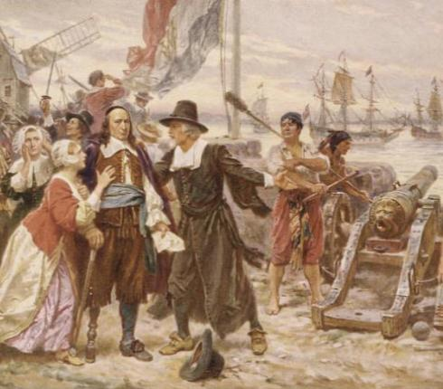
The 1st “middle” colony was New Netherland created by the Dutch West India Company
To attract settlers, the Dutch recruited Swedes, Germans, & Africans; New Netherland became very diverse
Britain did not like the Dutch a colony between their Chesapeake & New England colonies
In 1664, Britain seized the Dutch colony from Governor Stuyvesant & renamed it New York
Dutch governor Peter Stuyvesant resisted Britain’s takeover of New Netherlands but could not get the colonists to assist him
Notes:
Explain the development of the mid-Atlantic colonies; include the Dutch settlement of New Amsterdam and subsequent English takeover, and the settlement of Pennsylvania.

Slide 3
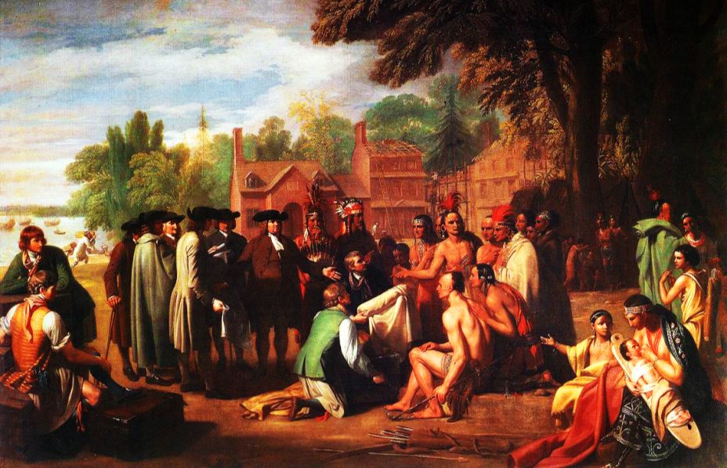
In what ways might Pennsylvania be different from other British colonies?

Slide 4
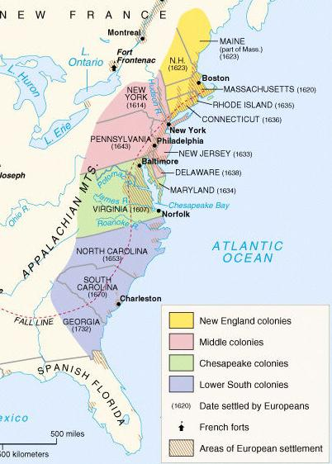
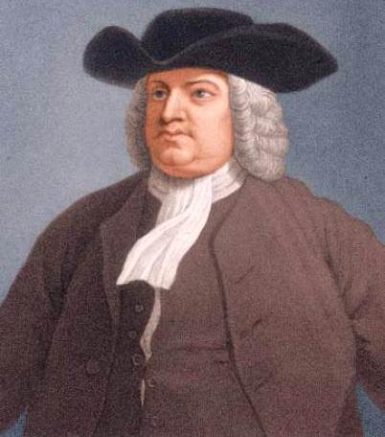
One of the most important middle colonies was Pennsylvania which was founded by William Penn in 1681

Slide 5
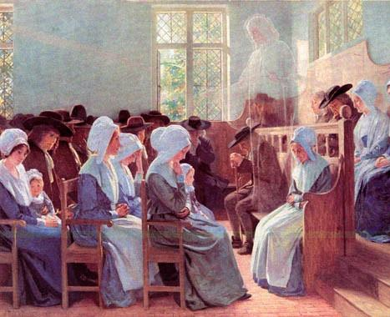
Penn was a member of a religious sect called Quakers who believed in the “Inner Light,” all people are equal, & that people can communicate directly with God

Slide 6
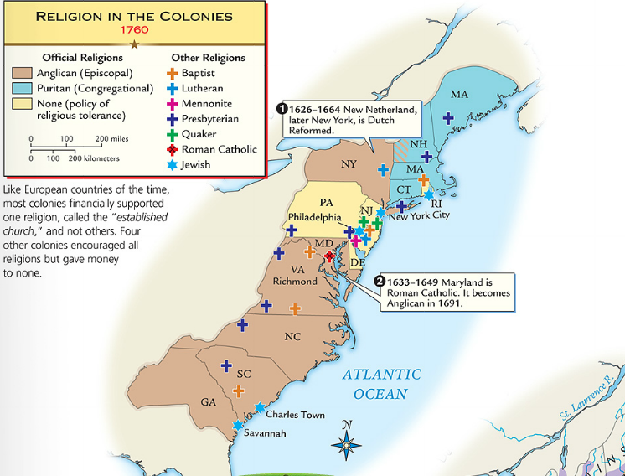
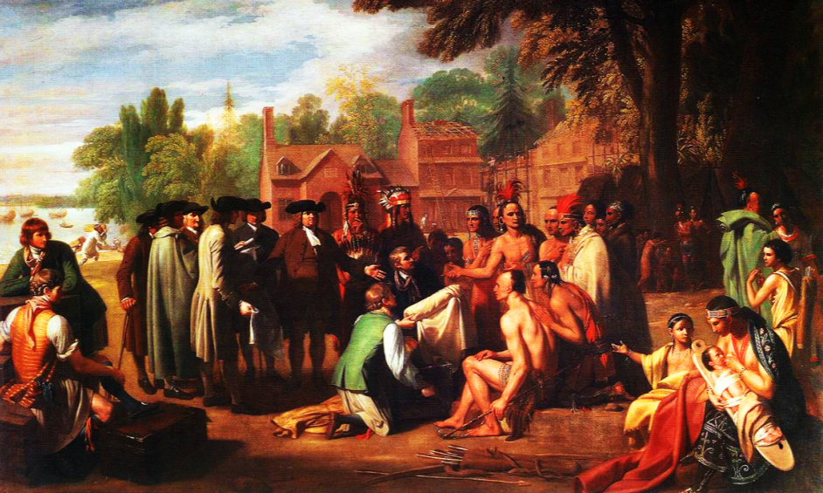
Penn founded his colony as a “holy experiment” to promote religious toleration
He bought land from the Indians, banned slavery, & allowed a diverse population to move there

Slide 7
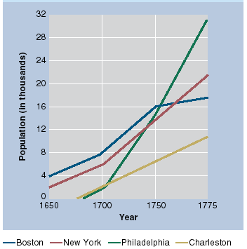
The middle colonies had two of the best ports for trade in America: Philadelphia & New York

Slide 8
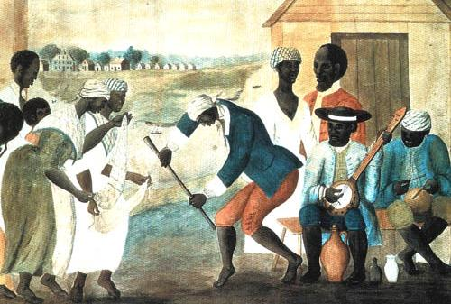
The image below is from the “Lower South” colony of South Carolina. Which other colony might it be similar to? Why?

Slide 9
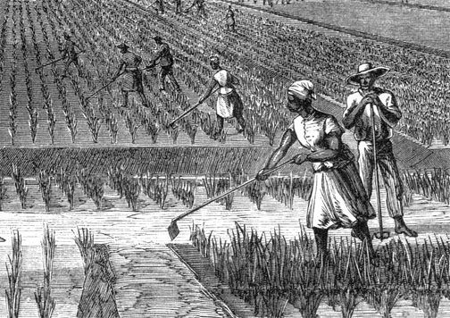
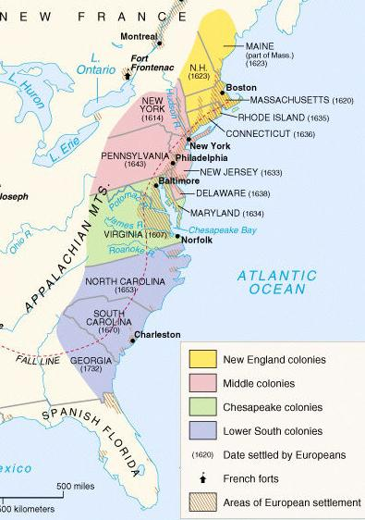
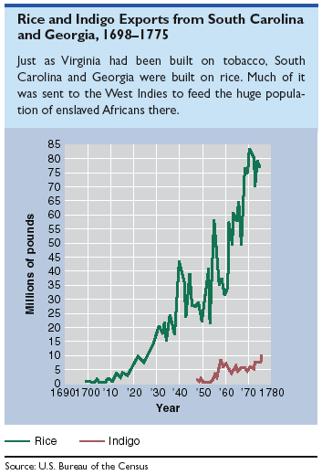
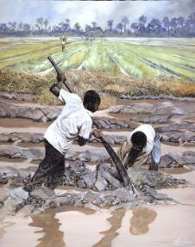
The Lower South colonies were the last British colonies to be formed
The Carolinas & Georgia developed like Virginia with a cash crop economy, slavery, & gaps between rich & poor colonists
Georgia was created by James Oglethorpe as a buffer colony between Carolina & Spanish Florida & was populated by British debtors & prisoners

Slide 10
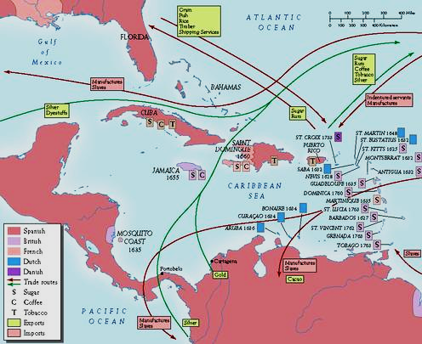
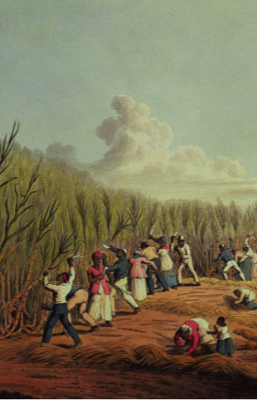
Colonies like Barbados & Jamaica were profitable, producing sugar for Britain
In addition to the 13 colonies, Britain had colonies in the Caribbean

