Slide 1
French Canada in the 17th Century
APUSH

Slide 2
French were late colonizers
What name is given to French Protestants?
Huguenots
Caught up in wars (foreign and domestic)
Catholics and Protestants fighting for dominance in France
Edict of Nantes (1598)- provided some toleration to Huguenots
Religious wars stopped
Long ruling Louis XIV (72 Years)
Stability allowed king to take interest in Colonies in N. America
Quebec Founded (1608)
Samuel de Champlain- “Father of France”

Slide 3
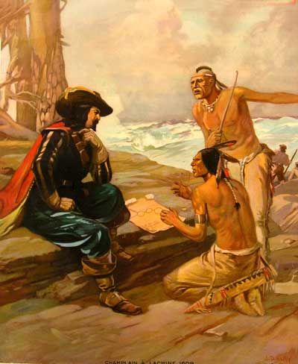
French Relationships With Natives
Champlain developed friendly relationships with Huron Indians
Helped to fight against enemies (Iroquois)
Became long time foes of the Iroquois
Population of New France stayed low
Denied Huguenots the right to emigrate

Slide 4
Resources of New France
Beaver was primary resource of New France
French trappers spread throughout the region (coureurs de bois)
Recruited Natives to fur trade
Decimated by disease and alcohol
French trappers moved into much of the central part of the continent
Jesuits sought to convert Natives
Catholic missionaries
Few converts, often tortured

Slide 5
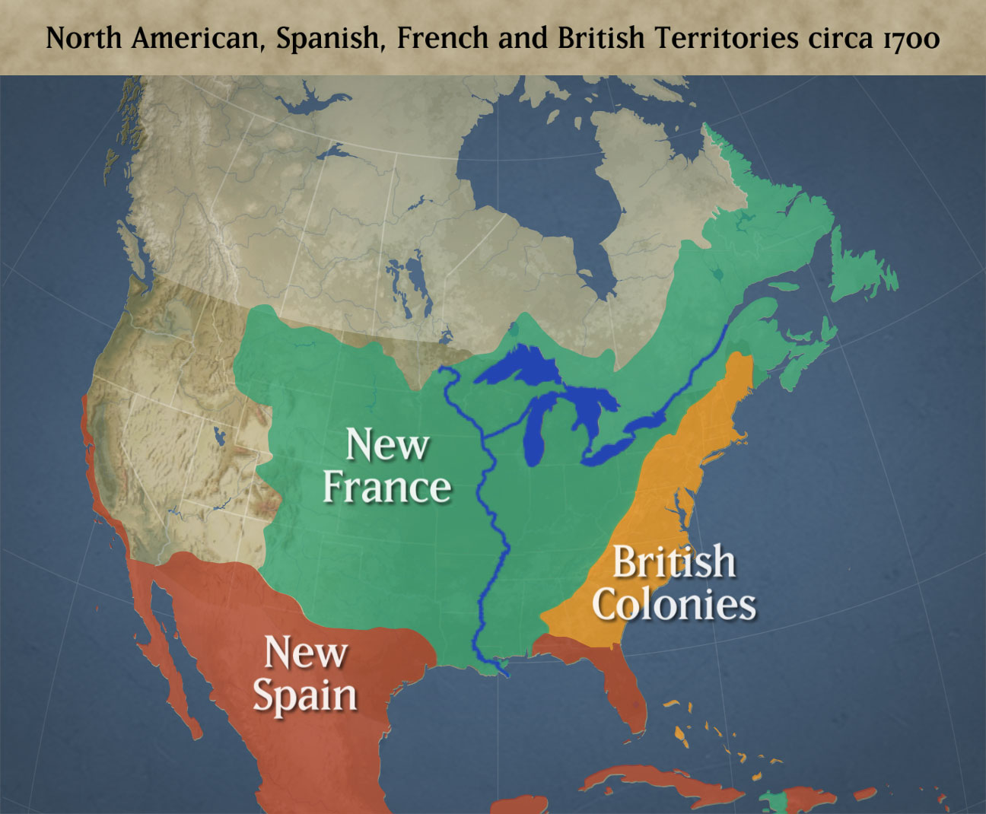
French Attempts at Keeping English/Spanish Back
Founded Detroit- 1701
Floated down Mississippi and claimed “Louisiana”- 1682
New Orleans fortified- 1718
Continental interior was large hunting ground for French trappers

Slide 6
Conflicts for Control in North America
King William’s War (1689-1697)- British vs. French in upstate NY and New England
Queen Anne’s War (1702-1713)- British vs. French in upstate NY and New England
War of Jenkin’s Ear (1739)- British vs. Spanish- mostly in Caribbean, French allied with Spain
King George’s War- (1748)- British vs. Spanish- French allied with Spain

