Slide 1
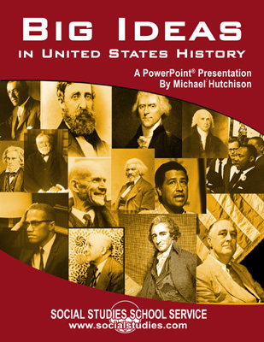

Slide 2
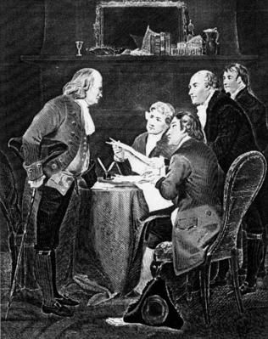
Moving Toward Independence
Thomas Paine’s Common Sense
Richard Henry Lee: “…free and Independent States.”
Continental Congress creates a “Committee of Five”
Notes:
Bullet #1 In early 1776, Thomas Paine published Common Sense, which presented several arguments in favor of independence. It became a runaway bestseller soon after publication. Many claim that Paine’s work did not necessarily develop new arguments for independence; however, it did present arguments in a manner that was easy to understand for many less-educated persons.
Bullet #2 The pamphlet also began to stir up sentiment in favor of independence within the Continental Congress. In the spring of 1776, Richard Henry Lee, a Continental Congressman from Virginia, moved that the “United Colonies are, and as a right ought to be, free and Independent States”.
Bullet #3 By the summer of 1776, Congress was ready to vote for independence, but needed to develop a suitable statement to declare their intentions. To that purpose, a “Committee of Five” was appointed to investigate and draft a formal declaration of independence. The committee included Benjamin Franklin, John Adams, and Thomas Jefferson. While Adams seemed the likely choice to write the Declaration, he decided to defer to Jefferson.

Slide 3
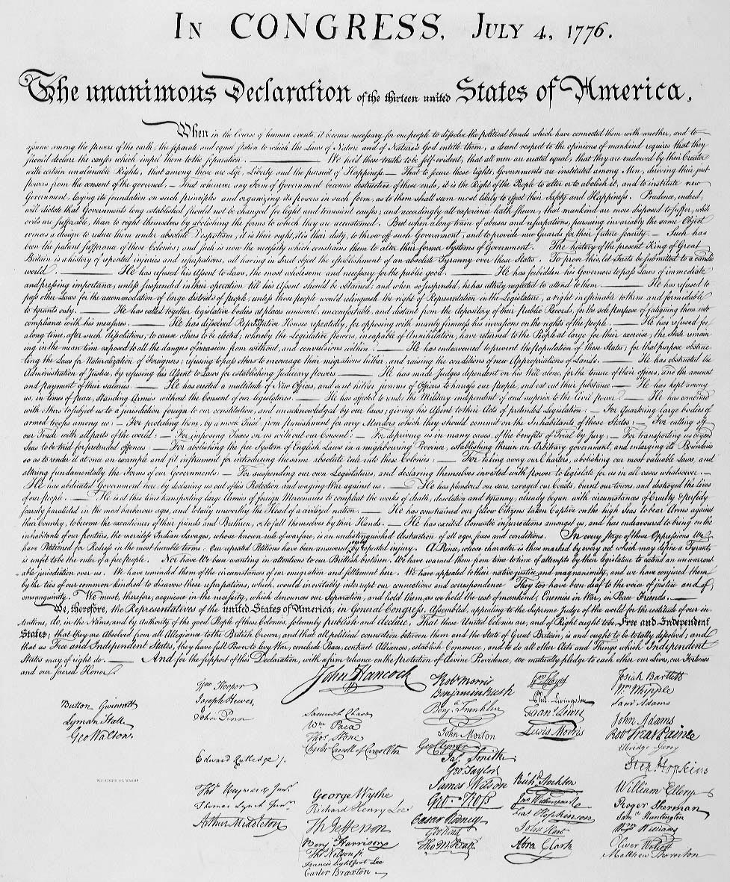
Declaration of Independence
Both a formal statement of independence and a declaration of war
Jefferson “borrowed” ideas from Enlightenment thinkers
Three purposes
Notes:
Bullet #1 The Declaration of Independence was not just a formal statement in which the colonies asserted the right to govern themselves; it was also a declaration of war against Great Britain.
Bullet #2 The Declaration borrowed heavily from the ideas of several Enlightenment philosophers and writers, including John Locke and Jean-Jacques Rousseau. Jefferson focused in particular on the notion of a “social contract,” noting that “whenever government becomes destructive of these ends (for which it was created), it is the right of the people to alter or abolish it.” Jefferson also asserted that people have “natural rights”, including, “life, liberty, and the pursuit of happiness.”
Bullet #3 Basically, the Declaration had three specific purposes. The first was to provide a statement of human rights and a philosophical discussion about when and why people have a right to break away from one form of government and replace it with another form. It is in this part that Jefferson made his famous (and controversial) assertion that “all men are created equal.” The second was to give a list of specific complaints, or grievances, against King George, spelling out the reasons why the colonies sought separation from England. The third purpose was a formal declaration of war, to which the colonies pledged their lives, their fortunes, and their “sacred honor.”

Slide 4
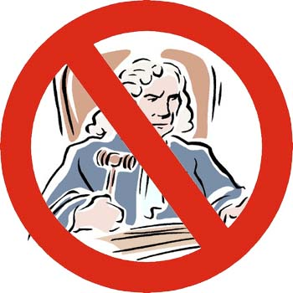
Weaknesses of the Articles of Confederation
No national unity, just 13 separate state governments
No ability to tax
No ability to regulate foreign or interstate commerce
Each state had only one vote in Congress, regardless of population
Support of nine of 13 states needed in Congress to pass important laws
Support of all 13 states needed to revise Articles
No executive branch
No national court system
Notes:
Even before the end of the Revolutionary War, the Continental Congress struggled with the framework of the new government that would need to be created after an American victory. The Congress wanted to avoid a government that concentrated power in the hands of one man, which they felt could lead to “tyranny” or even a new monarchy. Consequently, they purposely made central government under the Articles very weak and ensured the sovereignty of each state.
[Note to teacher: Briefly go over the points listed in the slide.]
While Congress did manage to pass some important legislation under the Articles (including the Land Ordinance of 1785 and the Northwest Ordinance of 1787), events such as national economic collapse and Shays’s Rebellion convinced many that the central government needed to be stronger so it could effectively deal with national issues and emergencies. A convention was scheduled in Philadelphia in 1787 to revise the Articles. It soon became apparent to the delegates, however, that they would need to write an entirely new document.

Slide 5
Framing of the Constitution
Most delegates were wealthy
Did the Constitution truly reflect democratic political ideals?
Madison’s role
Notes:
Bullets #1–2 Delegates met in the Philadelphia State House during the summer of 1787. Many of the delegates were wealthy planters, lawyers, and merchants. Because none of the delegates truly represented the “common man,” scholars have debated whether the Constitution reflected democratic political ideas or the economic and social interests of the wealthy delegates.
Bullet #3 By unanimous vote, George Washington was elected presiding officer of the convention. Because of his careful notes and analysis of the convention and its debates, James Madison is considered by many as the “Father of the Constitution”; historians, legal experts, and other scholars have often used Madison’s writings to interpret the views and goals of the framers.

Slide 6
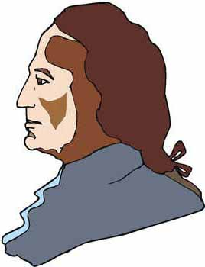
Different Views on Representation
Virginia Plan
Proposed by Madison
Protected large states’ interests
Allowed for a bicameral (two-house) legislature
Number of delegates in Congress based on a state’s population
Lower house would elect the upper house
New Jersey Plan
Proposed by Paterson
Protected small states’ interests
Allowed for a unicameral (one-house) legislature
Each state would have a similar number of delegates
Notes:
One of the first issues facing the delegates was that of representation; how should they determine the number of delegates each state would have in the legislative branch? James Madison proposed what became known as the “Virginia Plan,” which gave more power to the large states by providing them with more delegates to the Congress. Voters would be given some political power in as much as they would elect the lower house. The upper house, however, would be selected by the lower house.
The alternative was the “New Jersey Plan,” proposed by delegate William Paterson. In this plan, small states’ interests would be protected by a unicameral, or one-house legislature, with each state having an equal number of votes.
An impasse developed over the issue of representation, and it seemed for a while that the delegates wouldn’t be able to come to an agreement.

Slide 7
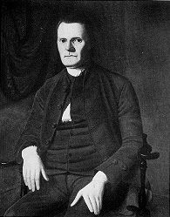
The Great Compromise
Bicameral legislature: the House of Representatives and the Senate
House representation based on population
Senate—each state allowed two votes
Length of terms for each
Senators selected by state legislatures
Roger Sherman
Notes:
Bullets #1–3 Connecticut delegate Roger Sherman offered a compromise to break the deadlock. The compromise included a bicameral (two-house legislature), with one house called the House of Representatives, and the other, the Senate. Sherman’s plan would protect the rights of both large and small states: representation in the House would be based on population (which favored the larger states), and each state would have two representatives in the Senate (which favored the smaller states).
Bullets #4–5 In addition, by allowing only a two-year term for House members in comparison to a six-year term for Senators, the framers afforded some measure of “aristocracy” for members of the “upper house.” States’ rights advocates were also satisfied because of a provision that stipulated that state legislatures would select the state’s senators. This would allow the state legislatures to have an important say in the running of the national government.

Slide 8
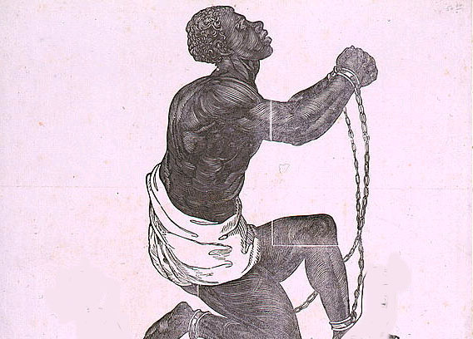
“Three-fifths” Compromise
How slaves should be counted for representation and taxation purposes
The compromise: 3/5^{ths} of the number of slaves would be counted for both representation and taxation
National government forbidden to interfere with the slave trade until 1808
Notes:
Bullets #1–2 Southern delegates felt that slaves should be counted toward representation in Congress but not for taxation. Northern delegates felt that slaves should be counted for taxation purposes, but not representation. The “Three-fifths” Compromise solved the issue by providing that 3/5^{ths} of the number of slaves would be counted for both representation and taxation. Ironically, the compromise never mentioned the word “slave.” Instead, it merely referred to the three-fifths as applying to “other persons.”
Bullet #3 Southern slaveholders were also concerned about the provision in the Constitution which gave the national government the power to regulate trade. They feared that non-slave states could someday use this provision to abolish the institution. In order to pass the compromise and allay the fears of Southerners, the convention delegates added to the Constitution a provision that forbade Congress to interfere with the slave trade for 20 years. Some historians have speculated that the reason Northerners accepted this part of the compromise was because many presumed that the “peculiar institution” of slavery would gradually die out and be extinct by 1808.

Slide 9
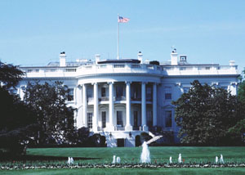
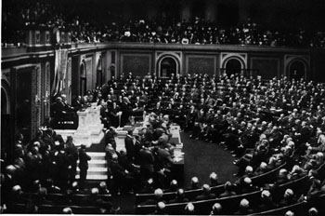
Governmental Power in the Constitution
Division of power
Separation of powers
Checks and balances
Notes:
Bullet #1 The framers determined that the Constitution should limit the national government in its power, but that the national government should have sufficient power to carry out necessary acts. In addition, the framers wanted to ensure that no single individual or part of the government should be more powerful than the other parts. In order to accomplish this, the framers first created the idea of “Federalism”, or “division of power.” In a federal system, the national government has certain powers “delegated” by the constitution (sometimes called “enumerated powers”). Some powers are “reserved” for state governments. Other powers are held concurrently by both state governments and the national government. Division of power guaranteed that national government would have the ability to do things like regulate commerce and respond to military threats, but it also ensured that state governments would retain some sovereignty.
Bullet #2 The idea of “separation of powers” came from Baron de Montesquieu’s 1748 work, The Spirit of the Laws. In this book, Montesquieu noted that the best form of government would be one in which the government is divided into three branches. A legislative branch would make laws, an executive branch would enforce the laws, and a judicial branch would interpret the laws.
The framers also created a system of “checks and balances” to further ensure that no branch of government could gain power over the other two. Each branch was given certain powers that allowed it to “check” the actions of the other two. For example, the president has the power to enter into treaties with other nations, but those treaties only become law with “the advice and consent” of the U.S. Senate.

Slide 10
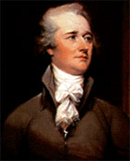
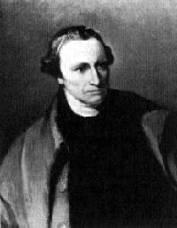
Federalists & Anti-Federalists
Anti-Federalists
Opposed the Constitution
Included Patrick Henry, Samuel Adams, Richard Henry Lee
Strongest in rural areas
Opposed a strong central government
Concerned the Constitution didn’t include a bill of rights
Federalists
Supported the Constitution
Included many framers (Washington, Hamilton, Madison)
Strongest in urban areas
Supported by those in favor of a strong central government
Supported by merchants, skilled workers, laborers
Alexander Hamilton
Patrick Henry
Notes:
Nearly immediately after the Constitutional Convention concluded its work and the delegates submitted it to the states for ratification, supporters and opponents of the document engaged in a series of spirited debates.
Supporters of the Constitution, also known as Federalists, praised the strong central government it would create as well as the concepts of separation of powers and federalism (which divided the power of government between the federal and state levels). Some of the more well-known Federalists were Alexander Hamilton (pictured above), George Washington, and James Madison. The Federalists tended to be concentrated more in cities and included many skilled workers and laborers.
The opposition, also known as Anti-Federalists, distrusted the idea of having a strong central government. Some of the more well-known Anti-Federalists were Patrick Henry, Samuel Adams, and Richard Henry Lee. The Anti-Federalists were also concerned that the Constitution did not include a Bill of Rights. Anti-Federalists tended to be concentrated in rural areas and included both small farmers and large plantation owners.
In an effort to gain public support, Hamilton, Madison, and John Jay published a series of essays in favor of the Constitution, titled The Federalist. The essays provided an in-depth analysis of the Constitution, including separation of powers, specific provisions, and its guarantee of majority rule balanced with sustaining minority rights. The Anti-Federalists countered with Letters from the Federal Farmer, written by Lee, which argued that the Constitution needed a bill of rights that would protect individual civil liberties such as freedom of expression and the right to a trial by jury.

Slide 11
The Bill of Rights
Written by James Madison
Important ratification issue
Madison submitted 17 amendments; Congress reduced number to 12, 10 were ratified
First Amendment guarantees “freedom of expression”
Second and Third Amendments protect against military control
Fourth through Eighth Amendments assure due process of law
Ninth and Tenth Amendments protect popular control over government
James Madison
Notes:
The Federalists had considered the idea of a statement of individual liberties (a “Bill of Rights”) as unnecessary because state constitutions already included similar statements, and the framers did not wish to encroach on state power and authority.
The Anti-Federalists, however, wanted some sort of statement protecting individual liberties from abuses by a strong national government; as a concession, the Federalists added a bill of rights to the Constitution. In actuality, the Bill of Rights is a “bill of limits”: instead of “giving” individuals fundamental rights such as freedom of speech, press, and due process, the Bill of Rights limits the government’s ability to restrict those rights. The U.S. Supreme Court has the final say on interpreting exactly where individual liberty ends and government authority begins.
The task of writing the Bill of Rights fell mainly to James Madison. Already renowned as the “Father of the Constitution,” Madison had to review thousands of suggestions from state legislatures for amendments; he eventually narrowed the field to 17. Congress revised Madison’s proposals, combining them into 12 amendments; 10 of the 12 were eventually ratified.

Slide 12
Louisiana Purchase
Purchased from France in 1803
Purchase price: $15,000,000 (three cents per acre)
Doubled the size of the U.S. to that point (800,000 more square miles)
Gave the U.S. complete control of the Mississippi River
Notes:
Spain’s decision to cede the Louisiana Territory back to France in the early part of the 19th century caused a great deal of concern for Americans, who worried about French intentions in the area. Jefferson, fearful that this public concern could potentially lead the U.S. into an alliance with Great Britain, dispatched Secretary of State James Monroe to negotiate a treaty with Napoleon to purchase the port at New Orleans as part of West Florida.
After a slave revolt in the French colony of Santo Domingo (Haiti), however, Napoleon decided to abandon his dream of a North American empire and sell all of Louisiana to the U.S. Jefferson knew that the territory would be a tremendous bargain, but the sale of Louisiana left him with a major philosophical dilemma.
In Jefferson’s view, the Constitution did not give the government the specific power to acquire new territory nor to establish new states. Jefferson was a proponent of keeping the country out of debt; not only would the purchase increase the national debt by $15,000,000, but Jefferson felt such an acquisition might be unconstitutional as well. He felt that the advantages of purchasing Louisiana far outweighed his misgivings, however, and he made an exception to his beliefs about the national debt and strict interpretation in order to buy the territory.

Slide 13
Marbury v. Madison Establishes Judicial Review
Marbury—a “midnight judge” to whom Jefferson denied a commission
Marbury sued under the Judiciary Act of 1789
U.S. Chief Justice John Marshall rules Marbury’s claim was invalid
Case established the concept of “judicial review”
Chief Justice John Marshall
Notes:
The text of the Constitution says very little about the judicial branch, and it doesn’t define in detail the powers and duties of the court system.
Bullets #1–2 The case of Marbury vs. Madison changed that concept. In this case, William Marbury, who had been appointed as a federal judge in the last days of John Adams’s presidency, did not receive his commission. The outgoing Federalist Party had given many such commissions in its final days in an attempt to pack the judiciary with Federalist-leaning judges. When Thomas Jefferson became president, he learned about these “midnight judges” and instructed Secretary of State James Madison not to deliver any of the commissions. Marbury sued the Jefferson Administration, seeking a “writ of mandamus” (a court order) forcing Jefferson to release the commission under the terms of the Judiciary Act of 1789, which created the federal court system.
Bullet #3 Supreme Court Chief Justice John Marshall faced a difficult task. If he ordered Madison to deliver the commission, Jefferson might cite his constitutional authority to name all federal judges and then simply refuse the order. If Marshall ruled in Jefferson’s favor, however, it would seem that the Court was merely bending to the president’s wishes, which would set a precedent and reduce the Supreme Court’s authority. Instead of merely choosing one of these two options, Marshall came up with a different solution. He stated that while Marbury WAS entitled to his commission, the section of the Judiciary Act which allowed for writs of mandamus was unconstitutional.
Bullet #4 More importantly, the Court’s unanimous opinion in the case asserted that only the Supreme Court could declare laws and actions unconstitutional, a concept now known as “judicial review.” Though Marbury greatly augmented the power and importance of the Supreme Court, Justices in the years since the decision have exercised this power infrequently on the federal level. In most cases involving judicial review, the Supreme Court has upheld the constitutionality of federal and state government laws and actions. The Court has declared acts of Congress to be unconstitutional only approximately 150 times since Marbury vs. Madison.

Slide 14
Monroe Doctrine
Part of President Monroe’s 1823 Message to Congress
Warned European powers not to interfere with Western Hemisphere affairs or overthrow independent republics there
Promised the U.S. wouldn’t interfere with European affairs or colonies
Roosevelt Corollary
Notes:
In the early part of the 19th century, several former colonies of Spain and Portugal rebelled and won their independence. Meanwhile, several European countries had formed an alliance to stop Napoleon Bonaparte and France. After Napoleon’s final defeat, it looked as if this alliance of countries might be willing to help Spain reestablish its empire in Latin America.
President James Monroe saw this as a direct threat to U.S. security; meanwhile, England believed that its lucrative trade in the Western Hemisphere would suffer if Spain regained its Latin American colonies. The U.S. and England therefore decided to issue a joint statement that guaranteed the independence of the new Latin American nations.
Bullets #1–3 Monroe, however, decided to go even further. In his 1823 Message to Congress, he not only warned European powers not to overthrow any of the newly independent Latin American republics, he also stated that they shouldn’t even “interfere” with the affairs of any country in the Western Hemisphere. In effect, Monroe declared the Western Hemisphere “off limits” to new colonization or exploitation. In return, he promised that the U.S. wouldn’t interfere with any existing European affairs or colonies.
While Monroe’s proclamation appeared to be made from a position of strength, the United States was far from capable at that point of militarily enforcing the provisions set forth in the doctrine. The real force of the doctrine came when the British endorsed it, backing their support of the document with the most powerful navy in the world at the time. The British thus provided de facto enforcement of the Monroe Doctrine.
Bullet #4 In the early part of the 20th century, President Theodore Roosevelt added a “corollary” to the Doctrine, noting that any “disorder” in Latin American might force the United States to “exercise an international police power”; in other words, the United States would use military force to protect its economic interests in the Western Hemisphere. The Monroe Doctrine was used to define and protect American interests in the Western Hemisphere several times in the 20th century, including European aggression in the West during World War II, and the 1962 Cuban Missile Crisis.

Slide 15
The American System
Proposed by Senator Henry Clay
High tariffs on imports
New transportation systems and internal improvements
Never completely implemented
Henry Clay
Notes:
Bullet #1–3 In 1815, Kentucky Senator Henry Clay proposed a system to enhance the nation’s economy as well as to unite various regions of the country. Clay’s plan became known as the “American System.” The plan included raising tariffs on imports in order to protect manufacturers, and developing better transportation by building new roads, canals, and bridges. Clay believed that the American System would promote a unified national economy, with the North providing industrial goods and the South and West providing cotton and food products. Better transportation would facilitate the flow of agricultural products to markets in the cities. In theory, the American System would make the U.S. economically independent of Great Britain and other European nations.
Bullet #4 Congress never fully implemented the American System, however, largely because of objections from Southern states. Southerners felt the plan was biased in favor of Northern manufacturers; they also didn’t want to pay for improvements in transportation because most of the states in the South could use rivers to move goods from one location to another.

Slide 16
The Bank of the United States
Second Bank of the U.S.
Chartered in 1816
Charter to expire in 1836; in 1832, Clay and Webster try to get it re-chartered early
Jackson vetoes the charter
“Pet banks”
Nicholas Biddle
First Bank of the U.S.
Created by Hamilton in 1791 to spur economic growth
Would provide for a “sound uniform currency”
Would act as a central bank for smaller state banks
Would provide a depository for tax money
Would issue paper money
Hamilton used the “elastic clause” to justify the Bank
Opposed by Jefferson, Madison, and other “strict constructionists”
Notes:
Alexander Hamilton was responsible for the first national bank in American history. He intended for the bank to fulfill many key functions: provide for a “sound uniform currency,” act as a central bank for smaller state banks, stabilize the nation’s weak economy, serve as a depository for tax money, and encourage economic growth and development—especially the development of manufacturing. Hamilton believed the national bank was constitutional under the so-called “elastic clause” of the Constitution, which allowed Congress to make any laws that were “necessary and proper” for the government to function effectively. Thomas Jefferson, James Madison, and other opponents of Hamilton held a stricter interpretation of the clause and claimed that the Constitution did not give Hamilton the authority to create a national bank. Eventually, Hamilton and his supporters convinced Congress to authorize a national bank with a 20-year charter. The First Bank of the United States began operating in 1791. It wasn’t very popular, however, and Congress let its charter lapse in 1811.
The Second BUS had been chartered in 1816 to help solve problems from financing the War of 1812. However, many felt the BUS had too much power and was dominated by Northeastern merchants. Jackson personally viewed the BUS as unconstitutional because it did not benefit the “common man” and thus failed as a public institution: the national government deposited all tax money in the Bank, yet only the Bank’s stockholders benefited from the profits this produced. Many Americans agreed with Jackson and opposed the Bank as a “privileged institution” that had an unfair advantage over other banks.
In 1832, Senators Henry Clay and Daniel Webster introduced a bill to re-charter the bank early, hoping to make it a campaign issue in 1832; they thought Jackson would veto the bill and undermine his own support. After Congress renewed the Bank’s charter, Jackson did indeed veto it. Clay and Webster’s plan backfired because the veto was hailed by many in the lower and middle classes. Jackson then announced that federal funds would no longer be deposited in the BUS, but would go instead into twenty-odd “pet banks” in various states. In an effort to preserve the bank and force Jackson to accept the re-chartering, Nicholas Biddle, the head of the BUS and a longtime opponent of Jackson, severely restricted credit and caused early foreclosure on many loans, causing an economic downturn. When business leaders appealed to Jackson for assistance, his reply to them was to ask Biddle. Finally, pressure forced Biddle to change the Bank’s loan policies; however, the damage had been done. Biddle unsuccessfully fought to keep the Bank alive as a private institution, and it ceased to exist after 1841.

Slide 17
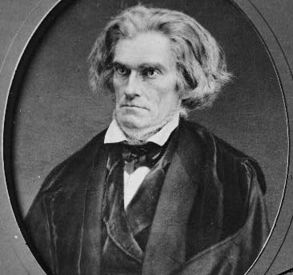
Nullification
Idea that states can refuse to enforce or obey federal laws
1828 “Tariff of Abominations”
South Carolina “nullifies” the tariff
The “Force Bill”
South Carolina Senator John Calhoun
Notes:
Bullet #1 During the 1820s and 1830s, tensions arose between the North and South that centered largely around issue of how much power the federal government had to enforce laws, and how much power the states retained for themselves. Southerners during this time felt that measures being passed in Congress tended to favor the North at the expense of the South. Many Southern leaders started to espouse the doctrine of “nullification”—the idea that a state could refuse to enforce or obey a federal law if they felt that law was unfair or unconstitutional.
Bullets #2–3 The Tariff of 1828 significantly raised the rate on manufactured goods, so much so that Southerners took to calling it the “Tariff of Abominations.” Many Southerners felt the tariff was unconstitutional since it seemed to blatantly favor the North at the expense of the South. Southerners hoped that the tariff would be revised in their favor under a Jackson presidency, but in 1832, Congress passed a bill that only made small changes in the existing tariff. Southerners were enraged, and the South Carolina legislature passed a bill “nullifying” the tariff and threatening to secede from the Union if Jackson tried to enforce it. South Carolina Senator John C. Calhoun then published the South Carolina Exposition, in which he explained and justified the doctrine of nullification.
Bullet #4 Jackson responded by having Congress pass a “Force Bill” that authorized him to use federal troops to collect the tariff in South Carolina, if necessary. The crisis was eventually defused when South Carolina senator John C. Calhoun worked with Kentucky senator Henry Clay to create a “Compromise Tariff” which slowly lowered duties over time. The ideas of “nullification” and secession would arise again in the 1860s as the nation headed toward the Civil War.

Slide 18
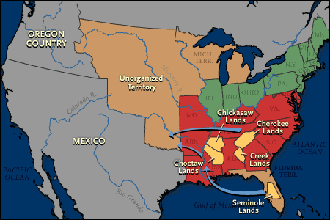
Indian Removal
Jackson orders removal of Indians to the west
1830: Indian Removal Act
Jackson uses military force to move certain tribes
The Trail of Tears
Notes:
During Jackson’s term, many whites had differing opinions about how to handle Native American tribes. White land speculators, farmers, and entrepreneurs believed that the U.S. should take over Indians’ land and resources in order to maximize the economic potential of these “assets” by “developing” them. Others believed that Indians should be converted to Christianity, taught agricultural skills and trades, and absorbed into American society.
Bullets #1–3 Jackson personally believed that the Indians could not be assimilated, and he favored moving them out to the country’s western frontier. Many in Congress shared this view, and in 1830, the Indian Removal Act was passed. The act empowered the president to negotiate removal treaties with Indian tribes living east of the Mississippi. Little “negotiation” actually took place; instead, the government strongly pressured many Indian tribes to accept these treaties and move west. Jackson eventually used the military to enforce removal for certain tribes.
Bullet #4 Jackson’s successor, Martin van Buren, continued the policy of removal. Perhaps the most tragic incident in the sad history of removal occurred when Van Buren ordered General Winfield Scott to remove the Cherokee and take them to western territories. Scott and the army led the Cherokee on a brutal march that came to be called the “Trail of Tears.” Over one-quarter of the number of Cherokees that started the forced march died en route to the new reservations; those who survived found that their new lands in the west were markedly inferior to those from which they had been removed.
Ultimately, five southeastern Native American nations were forcibly relocated west, opening up 25 million acres of land for whites.

Slide 19
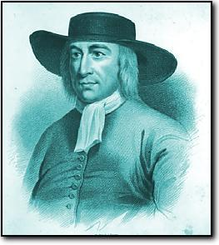
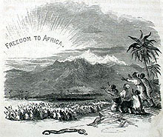
Abolitionism
Roots: the Quakers
American Revolution
Early 1800s: Slavery ends in the North
Colonization movement
Notes:
Bullets #1–3 American abolitionism’s roots lie largely with the Quakers, who believed that it was a sin for a human being to own another human. The Quakers’ view on slavery gained support in the North during the 17th and 18th centuries. The Declaration of Independence—with its focus on individual rights, freedoms, and the idea that “all men are created equal”—also played a part in undermining slavery in the North. In addition, because large-scale agriculture wasn’t really economically viable in the North, the region had less demand for slaves. By the early 19th century, all the mid-Atlantic and New England states had either ended slavery or made provisions to do so in the near future.
Bullet #4 Some in the abolitionist movement supported emancipation only if it was accompanied by “colonization,” a plan in which freed slaves would be send to an independent colony to be established in Africa. Many saw colonization as a way to end the evil of slavery without having to deal with the thorny issue of establishing the freedmen in society on equal footing with whites. In 1822, President Monroe helped the American Colonization Society found the nation of Liberia in west Africa. Though a number of ex-slaves did indeed migrate to Liberia, most black people had little connection to the Africa of their ancestors. They considered themselves Americans and rejected the idea of colonization.

Slide 20
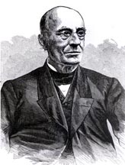
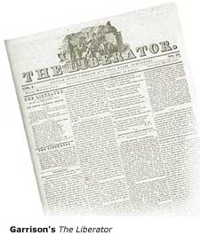
Abolitionism (continued)
William Lloyd Garrison
Gradual vs. immediate emancipation
Garrison and The Liberator
Southern reactions
Notes:
Bullet #1 Abolitionists tended to fall into one of two camps. “Gradual emancipationists” believed that slavery—if kept confined to the South and not allowed to spread to new states in the west—would eventually die out. Some believed that compensated emancipation—paying slave owners to free their slaves—would facilitate this process. The more radical “immediate emancipationists” rejected compensation and other “compromise” ideas, pushing for an end to slavery everywhere at once.
Bullet #2 One of the most radical of the antislavery leaders in the North was William Lloyd Garrison, who founded the New England Anti-Slavery Society as well as the National Anti-Slavery Society. He also published the most prominent of the anti-slave newspapers: The Liberator. Many blacks supported Garrison’s radical views: nearly 75% of the membership of his Anti-Slavery Society were African American. Garrison’s fervor for the abolitionist cause attracted many followers, but it also alienated many moderate whites. Many shied away from him because he criticized churches and the federal government for not doing more to condemn slavery.
Bullet #3 Though most abolitionists were moderates, the radical views received the most attention—especially calls for a slave revolt, as advocated by ex-slave David Walker. A slave uprising was the South’s greatest fear, since blacks in the region outnumbered whites significantly. Slave owners responded to the strident proclamations of the radicals by defending their “peculiar institution” more and more strongly. Ultimately, the abolitionist movement succeeded more at outraging Southerners than converting Northerners to the cause. Although only a minor part of the population in the North were actively involved in the abolitionist movement, they had an important effect on the nation as a whole. The abolitionists increased the debate over slavery and polarized opinions about it; in the end, their efforts ended up exacerbating the tensions between North and South and helped lay the groundwork for the Civil War.

Slide 21
Frederick Douglass
Born as a slave in 1817
Taught to read and write by the wife of his owner
Escaped from slavery
A leading abolitionist speaker
Founded his own anti-slavery newspaper, The North Star
Notes:
Bullets #1–3 Unlike the vast majority of slaves, Frederick Douglass had been taught to read and write as a child and went on to become a voracious reader. Because of his education and natural intelligence, Douglass’s master allowed him to train to be a ship caulker and then hired him out in Baltimore. Although Douglass held a privileged position compared to other blacks in the South (he wasn’t in the Deep South, he had a job as a skilled laborer, and he lived in a city instead of on a plantation), he was still a slave and wasn’t allowed to keep his wages or live his life the way he wanted. He managed to escape in 1838, then moved to New York and soon became a leading spokesman for the abolitionist movement.
Bullet #4 Douglass was a powerful speaker and usually made a lasting impression on the audiences to which he spoke, and huge crowds flocked to hear him speak. In addition, the fact that a black man and ex-slave could be well-read and articulate challenged the common view that slaves were inferior or sub-human. Southern supporters of slavery even tried to use Douglass’s intelligence to undermine his public image, claiming that Douglass was too well educated and well spoken to have ever been a slave. In 1845, the American Anti-Slavery Society helped publish The Narrative of the Life of Frederick Douglass. Though the autobiography proved a potent tool for abolitionists, Douglass feared that the notoriety it brought him increased the risk that he might be abducted and returned to slavery. He decided to go to England and lecture to audiences there; while he was away, supporters raised enough money for Douglass to buy his freedom.
Bullet #5 While some supported more radical and sometimes violent views regarding abolition, Douglass preferred using political actions to combat slavery. Unlike Garrison, he did not view the Constitution as a “pro-slavery document,” believing instead that it could “even be wielded in behalf of emancipation.”
Douglass not only provided one of the strongest voices in the abolitionist movement, but also became a role model for both ex-slaves and free blacks. He helped recruit black soldiers during the Civil War, campaigned after the war for full civil rights for African Americans, and later served as the U.S. minister to Haiti. He died in 1895.

Slide 22
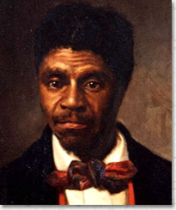
Dred Scott vs
Sandford 1857
Background
Dred Scott was a slave in Missouri.
From 1833 to 1843, he resided in Illinois (a free state) where slavery was forbidden by the Missouri
After returning to Missouri, Scott sued unsuccessfully in the Missouri courts for his freedom, claiming that his residence in free territory made him a free man.
Scott then brought a new suit in federal court
Question
Was Dred Scott free or slave?
Conclusion
held that African Americans, whether enslaved or free, could not be American citizens and therefore had no standing to sue in federal court
the federal government had no power to regulate slavery in the federal territories

Slide 23
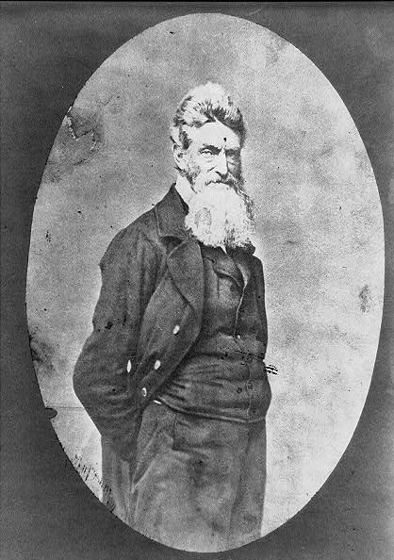
John Brown
Radical abolitionist
Led bloody anti-slave raids in Kansas
Sought to arm slaves to start a rebellion against white masters
Failed plot to seize arsenal at Harpers Ferry
Put on trial for treason; eventually found guilty and hanged
Became a potent symbol for both Northerners and Southerners
Notes:
Bullet #1 While abolitionist leaders such as Garrison used fiery language and rhetoric to support their anti-slavery agenda, others advocated much more extreme measures. Though not considered a leader in the abolitionist movement, John Brown’s incendiary antislavery acts raised him and the movement to the forefront of the public’s consciousness. Perhaps more than any other abolitionist, Brown helped light the powder keg that would explode in civil war.
Bullet #2 Brown had come to believe that he had been divinely appointed to lead a “holy war” to end slavery at all costs. He began to build his reputation as the most radical of abolitionists when he and five of his sons jumped into the conflict between pro- and anti-slavery forces in “Bleeding Kansas” in 1855. The Browns conducted bloody raids at Lawrence and Pottawatomie Creek, slaughtering several proslavery settlers—actions that shocked many in both the North and the South. His abortive raid on the federal arsenal at Harpers Ferry, Virginia, would prove even more shocking.
Bullets #3–4 Brown believed that if he could could conduct raids in the South in which he would free and arm small groups of slaves, it would eventually spark a massive slave rebellion. He devised a plan to attack the U.S. armory at Harpers Ferry, which he hoped would provide the spark that would incite slaves to revolt; he also hoped to distribute the armory’s weapons to his incipient slave army. In 1859, Brown and a group of about 20 followers attacked and seized the armory. The slave rebellion never materialized, however, and two days later, federal troops retook the armory.
Bullets #5–6 Brown was put on trial for treason, insurrection, and murder. The proceedings received national press coverage and captured the attention of people in both the North and the South. An unrepentant Brown stated that he felt “no consciousness or guilt” over what he had done. He was found guilty and hanged on December 2, 1859. By the time of his execution, many northerners had come to regard Brown as a visionary; he was immortalized in song in “John Brown’s Body,” which Union troops often sang during the Civil War. On the other hand, Southerners became fearful that every northerner shared Brown’s views and goals, and regarded every move made by the North with even more suspicion than they had in the past. Ultimately, Brown’s raid led to increased sectionalism and antagonism and accelerated the country’s slide into civil war.

Slide 24
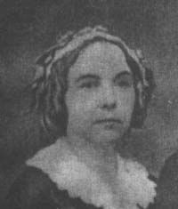
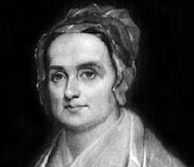
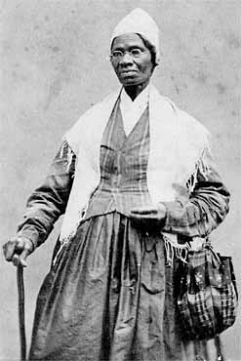
Early Women’s Rights Movement
Lucretia Mott
Elizabeth Cady Stanton
Grew out of the abolitionist movement
Lucretia Mott and Elizabeth Cady Stanton
Sojourner Truth
Sojourner Truth
Notes:
Bullets #1–2 Many of the people who supported abolition also supported greater rights for women. Women’s rights remained in the background, however, until the 1840s, when Quakers Lucretia Mott and Elizabeth Cady Stanton traveled to London for an international anti-slavery convention. Infuriated that women were not allowed to speak at the meetings there, Mott and Stanton vowed to start a “society to advocate the rights of women” when they returned to America.
Bullet #3 Meanwhile, an escaped slave who had taken the name “Sojourner Truth” was becoming a popular speaker at abolitionist conventions. Her anti-slavery talks also touched on women’s rights issues, most notably in her famous “Ain’t I a Woman?” speech in which she declared:
“Look at me! Look at my arm! I have ploughed and planted, and gathered into barns, and no man could head me! And ain’t I a woman? I could work as much and eat as much as a man—when I could get it—and bear the lash as well! And ain’t I a woman? I have borne thirteen children, and seen most all sold off to slavery, and when I cried out with my mother’s grief, none but Jesus heard me! And ain’t I a woman?”
As the incipient women’s rights movement grew, its supporters wanted Truth to shift her focus away from slavery. Truth refused, however, and earned the enmity of many women’s rights advocates. While Truth never learned to read or write, she did dictate her autobiography, The Narrative of Sojourner Truth: A Northern Slave, which was published in 1850.

Slide 25
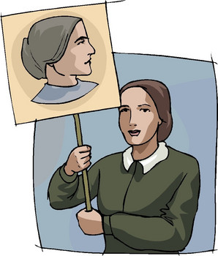
Seneca Falls Declaration of Sentiments
Brainchild of Elizabeth Cady Stanton and Lucretia Mott
Closely modeled on the Declaration of Independence
Called for equality for women
Resolution calling for women’s right to vote passes narrowly during convention
Notes:
Bullets #1–2 In 1848, under the guidance of Elizabeth Cady Stanton and Lucretia Mott, a women’s rights convention was held in Seneca Falls, New York. One of the focal points of the convention was the adoption of a “Declaration of Sentiments” advocating equality and rights for women. Stanton based the “Declaration of Sentiments” closely on Jefferson’s words in the Declaration of Independence, stating, “We hold these truths to be self-evident: that all men and women are created equal…” Stanton also compiled a list of “injuries and usurpations” (also echoing the Declaration of Independence) that had been committed “on the part of man against woman.”
Bullets #3–4 In addition, Stanton included 11 resolutions that addressed reform issues for which women had worked for years, including equality with men, equal employment opportunities, and moral equality. The convention passed all the resolutions unanimously except the ninth, which called for women’s right to vote. Stanton shocked the convention with this resolution, which reached much further than most women’s rights advocates at the time intended; even a surprised Mott told her, “Why, Lizzie, thee will make us ridiculous.” A contentious debate ensued, but Frederick Douglass (who resided in nearby Rochester, where The North Star was published) made an eloquent speech in favor of the resolution. In the end, it passed narrowly.
While the Seneca Falls Conference and Declaration of Sentiments represented an important first step, the struggle for women’s rights and equality would still be long and difficult. Women didn’t obtain the right to vote until more than 70 years after the Seneca Falls Convention, and many feel that women have yet to attain full political, economic, and social equality.

Slide 26
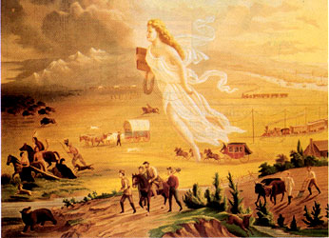
Manifest Destiny
Belief that the United States was destined to expand and control the North American continent
Often used to justify territorial expansion
Impact on the westward movement
Conflicts
Notes:
Bullets #1–2 In 1845, journalist John L. O’Sullivan wrote, “It was the nation's manifest destiny to overspread and to possess the whole of the continent which Providence has given us for the development of the great experiment of liberty and federated self-government entrusted to us.” O’Sullivan had meant to extol the superiority and benefits of American democracy; however, the concept of “manifest destiny” came to be used mostly as a justification for territorial expansion.
Bullet #3 Manifest destiny helped fuel the westward movement, providing a philosophical impetus and a sense of mission to the dream of economic opportunity that motivated many to make the journey west. It also helped people rationalize the acts they committed in order to settle the West: subjugation, relocation, and even the murder of native tribes; despoiling the environment by exploiting its natural resources; and disrupting a region’s ecology by damming rivers, introducing non-native crops, and hunting species such as the bison to the point of extinction.
Bullet #4 Manifest destiny also sometimes led to large-scale conflicts. In some instances (such as American acquisition of the Oregon Territory) disputes were settled without war or bloodshed. In other instances (the annexation of Texas, the seizure of Mexican territories after the Mexican-American War, wars with the Indians), the U.S. found itself employing military force to achieve the idea of Manifest Destiny.

Slide 27
Rise of the Republican Party
John C. Fremont
Slavery splits Whig Party
Abolitionist Whigs drawn to Liberty Party, later to Free Soil Party
Republican Party founded in 1854 in Wisconsin; opposes Kansas-Nebraska Act and expansion of slavery in territories
Fremont loses in 1856, but Republicans prove a viable party
Notes:
Bullet #1 By the mid 1850s, many Whigs had become frustrated with the party’s consistent flip-flop on the issue of slavery. Some leading party members, such as newspaper publisher Horace Greeley, began to look for an alternative political organization that had a stronger anti-slavery platform. That would be the Republican party.
Bullet #2 The Republican Party evolved from smaller political organizations such as the Liberty Party that made anti-slavery a central credo. While the popular vote for the Liberty Party in the 1844 election was small, many abolitionists saw those gains as encouraging. By 1848, the Liberty Party was replaced by the Free Soil Party, which nominated former President Martin Van Buren as their candidate. Van Buren ran on a platform of “free soil, free speech, free labor, and free men”; though he didn’t win the election, he did garner enough votes to influence the result of the election by throwing his support behind the Democratic candidate, Zachary Taylor. By 1852, however, the Free Soil Party had splintered: it did not have an impact in that year’s presidential race, and many members began to look elsewhere for a party to represent their views and ideals.
Bullets #3–4 In 1854, a group of disaffected Whigs, Free Soilers, and Democrats formed the Republican Party. The major platform of the new party was to oppose the expansion of slavery into both new states and territories acquired by the U.S. “Bleeding Kansas” and the resulting contested territorial election there heightened public concern about the expansion of slavery and helped raise the Republicans to national prominence. In the 1856 presidential election, the Republicans nominated John C. Fremont, a popular former explorer and general nicknamed “the Pathfinder.” The Democrats picked James Buchanan, a former congressman and Secretary of State who was currently serving as minister to Great Britain. Buchanan was morally opposed to slavery, but felt that the issue should be decided by individual states rather than the federal government. Although Buchanan won the election, Fremont came in a strong second, establishing the Republican Party as a viable force in U.S. politics. Fremont’s showing also helped the party gain legitimacy, paving the way for the election of Abraham Lincoln four years later.

Slide 28
Popular Sovereignty
Cartoon caption: “Liberty, the fair maid of Kansas in the hands of the “border ruffians”
Idea that residents of a new territory should have the right to choose whether slavery would be legal or illegal there
Douglas and the Kansas-Nebraska Act
“Bleeding Kansas”
Illinois Senator Stephen A. Douglas
Notes:
Bullets #1–2 Popular sovereignty—the idea that residents of a new territory should have the right to choose whether slavery would be legal or illegal there—provided a way for North and South to compromise over a potentially explosive issue. In the early 1850s, the disposition of the Nebraska Territory posed yet another threat to sectional harmony. In 1854, Senator Stephen A. Douglas of Illinois crafted legislation he hoped would resolve the issue. Douglas proposed splitting the vast territory in two and letting the issue of slavery in the territories be decided by popular sovereignty. Douglas’s proposal, known as the Kansas-Nebraska Act, satisfied many and managed to pass in Congress. Many Northerners, however, felt betrayed by the act because the Missouri Compromise of 1820 had banned slavery in territory north of 36° 30'—which included both the Kansas and Nebraska territories.
Bullet #3 Instead of peacefully resolving the issue, the act turned Kansas into a violent battleground. Pro-slavery forces such as the “Border Ruffians” attacked anti-slavery settlers; anti-slavery forces would then respond in kind by attacking pro-slavery settlements. Perhaps the most shocking act came when abolitionist John Brown and his sons slaughtered proslavery settlers at Pottawatomie Creek. By late 1856, the territory had earned the nickname “Bleeding Kansas.”
The events in Kansas showed the limits of popular sovereignty. While it could work as the basis for compromise in some situations, it proved inadequate to handle an issue as large and inflammatory as slavery.

Slide 29
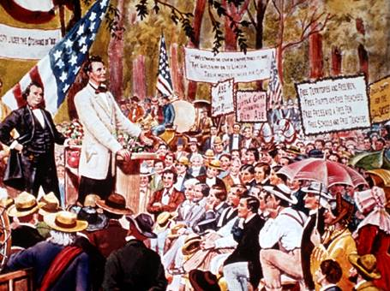
The Lincoln-Douglas Debates and the “Freeport Doctrine”
Abraham Lincoln challenges Stephen A. Douglas for Illinois Senate seat
“Freeport Doctrine”: comes up in the second debate
Douglas alienates Southern Democrats but wins the Senate seat
1860 presidential election
Notes:
A few months after James Buchanan was elected president in 1856, several events intensified the tensions between North and South over the issue of slavery. First, in the case of Dred Scott vs. Sanford, the Supreme Court ruled that slaves were not citizens; the Court’s decision also declared that the Missouri Compromise, which had barred slavery in territory north of 36° 30', was unconstitutional. Later in the year, Buchanan endorsed Kansas’s pro-slavery Lecompton Constitution.
Bullet #1 In 1854, Senator Stephen A. Douglas found himself in a battle for reelection that year against Abraham Lincoln. While Lincoln was known in central Illinois, he had to combat Douglas’s national reputation and backing. He therefore challenged Douglas to a series of debates around the state. Lincoln and Douglas differed the most in their views on slavery. Douglas believed that slavery would die out because of popular sovereignty: the majority of people would eventually realize that slavery wasn’t an effective labor system, and it would die on its own. Lincoln, on the other hand, believed that if slavery were extended to new territories, it would never die out. He felt that the only way to stop slavery would be to pass legislation outlawing its spread into the territories.
Bullets #2–4 In the second debate between Lincoln and Douglas, held in the town of Freeport, Lincoln asked his opponent a simple, yet essential question regarding his views on the idea of popular sovereignty in light of the recent Dred Scott decision. Lincoln already knew how Douglas would answer, but he wanted him to state his response publicly. Douglas did exactly as Lincoln hoped, responding that even with the Dred Scott decision, slavery could not exist anywhere that the population did not wish it to exist—the essence of popular sovereignty. While Douglas’s statement most likely won him support in Illinois, it did serve to worsen the split between the northern and southern wings of the Democratic Party. In 1860 when Douglas ran for president, Southern Democrats left and formed their own “Constitutional Union” party, nominating Vice President John C. Breckinridge. This division proved fatal: in the November election, Republican candidate Abraham Lincoln won with less than 40% of the popular vote. Lincoln did not carry any states in the south, and Douglas won just two states—Missouri and New Jersey.

Slide 30
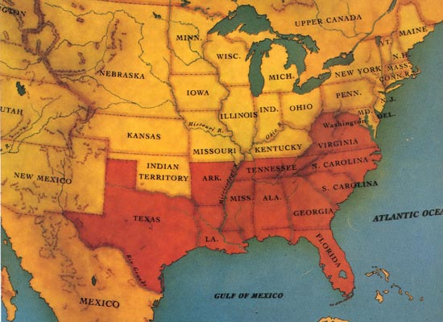
Secession
Idea that individual states retained the right to withdraw from the Union
South Carolina nullification crisis, 1832
Lincoln’s election/Southern states secede
The Civil War
Notes:
Bullet #1 The concept of secession raised a major question about the basic nature of the United States: was America a confederation of independent states or was it a single, unified nation? Secessionists held the former view and claimed that the U.S. was akin to an alliance between countries. “Sovereign” states had entered into the Union because it was mutually beneficial; when a state no longer felt that the arrangement worked to its benefit, it retained the right to withdraw from the Union. Anti-secessionists held a different view: when a state joined the Union, it placed itself under the power of the federal government and gave up its “sovereignty.” Consequently, any attempt at secession would be illegal.
Bullet #2 Though the concept of secession had been around since the beginning of the nation, no state had felt the need to use it until the “nullification” crisis of 1832. Congress had passed a tariff bill that the state of South Carolina felt was unfair and detrimental to the state’s interests. The state legislature passed a resolution “nullifying” the tariff and refused to enforce it. Nullification and secession both stem from the same basic idea: individual states have the power to defy federal law if they feel it goes against their best interests or is unconstitutional.
Bullet #3 Many in the South believed that Abraham Lincoln’s election in 1860 meant their region would no longer have a voice in the federal government. In December of that year, South Carolina became the first state to secede. Alabama, Florida, Georgia, Louisiana, Mississippi, and Texas soon followed. These states held a convention in early 1861 and formed the Confederate States of America, choosing Jefferson Davis of Mississippi as its first president.
Bullet #4 From today’s perspective, it seems clearly apparent that the Civil War was fought over the issue of slavery, but many people at the time did not view it that way. Before the South seceded, a significant portion of the North remained uncomfortable with the idea of fighting a war to end slavery; in fact, many people had no problem with the idea of keeping blacks in bondage. However, many Northerners found they could support the Civil War without taking a position on slavery: in they were fighting to “preserve the Union,” not to abolish slavery. Similarly, many Southerners felt that they were fighting not for slavery but to assert their inalienable rights in the face of a “tyrannical” government bent on subjugating them—just as the Founding Fathers had in the American Revolution.

Slide 31
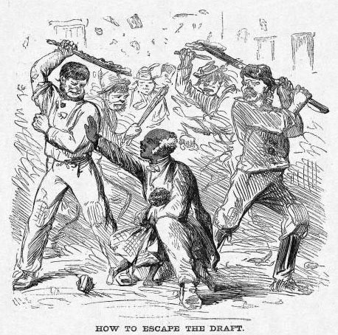
Conscription and the Draft Controversy
First military draft in U.S. history (1863)
Exceptions: substitutes, slave owners
New York City draft riots
Other drafts in American history
Notes:
Bullets #1–2 There had never been a draft law in U.S. history prior to the Civil War. During the conflict, both North and South eventually resorted to conscription. Government officials hoped that many would see the draft as the “great equalizer” because conscription would mean that men from all social classes would fight together in war. Several loopholes, however, allowed for the wealthy or those who were slaveholders in the South to avoid military service. In the Union, a man wishing to avoid military service could pay a substitute $300 to take his place. In the Confederacy, all slaveholders owning more than 20 slaves received an automatic exemption. Some men accepted roles as substitutes, only to desert, change their names, and collect a substitute fee from someone else. Many who were unable to avoid military service soon began to call the Civil War “a rich man’s war, but a poor man’s fight.” By the end of the war, only approximately 40,000 men in the army were actually draftees, while the rest—more than 90% of the total—had volunteered.
Bullet #3 Many immigrants and poorer whites in Northern cities opposed the war because they disliked blacks and feared that abolition would result in a huge influx of ex-slaves coming to the North and competing with them for jobs. In July 1863 in New York City, anti-draft sentiment boiled over and major riots erupted. White workers took out their anger over the draft by attacking free blacks and rich whites who had avoided the draft by paying for substitutes. After the smoke had cleared, nearly 100 persons had been killed and millions of dollars in property damage had occurred.
Bullet #4 The draft was later used in both World War I and World War II; no huge outcry resulted either time and people tended to accept conscription as a necessity. During the Korean War, however, opposition to the draft developed. By the Vietnam War, the draft had become a major point of controversy. Protesters in the 1960s echoed some of the arguments that immigrants and lower-class whites had made during the Civil War: it was wrong to force people to fight in a conflict they opposed, and the unfairness and inequality of the draft. Many richer families were able to protect their sons from military service by procuring hard-to-get alternatives for them: student deferments, National Guard and Coast Guard posts, and more. The army that ended up fighting in Vietnam drew largely from the lower classes and included a disproportionate number of African Americans.

Slide 32
Transcontinental Railroad • Homestead Act
Both enacted in 1862 during the Civil War
Both encouraged western expansion and settlement
Pacific Railway Acts
Homestead Act
Notes:
Bullets #1–2 Even during the war years, the government embarked on plans to make it easier for settlers to migrate westward and to fairly distribute lands in the West. The mainstays of these plans were the construction of a transcontinental railroad and the passage of the Homestead Act.
Bullet #3 Under the Pacific Railway Acts, the federal government promised large grants of land to the companies that would build the transcontinental railroad: for every mile of rail they built, each company would give alternate sections of land on each side of the railroad. Two competing corporations won the contracts to build the transcontinental railroad: the Union Pacific Railroad would go westward with one line, while the Central Pacific Railroad would build eastward from California with the other. The railroad eventually reached completion when the Central Pacific’s and Union Pacific’s lines tracks were joined in May 1869 at Promontory Point, Utah.
Bullet #4 The Homestead Act was an attempt to equitably distribute land in the West. Anyone could claim a one-quarter section (160 acres) of land in the west if they fulfilled the following conditions: within a five year period, they had to construct a house on the land, dig a well, plow 10 acres of the land, fence some of it in, and actually live on it. While many favored the Homestead Act, it did cause some controversy. Homesteaders’ fences ended up cutting off some of the land that ranchers had long used for free grazing of cattle, leading to conflict—and sometimes all-out violence—between homesteaders and ranchers, such as the Johnson County War in Wyoming.

Slide 33
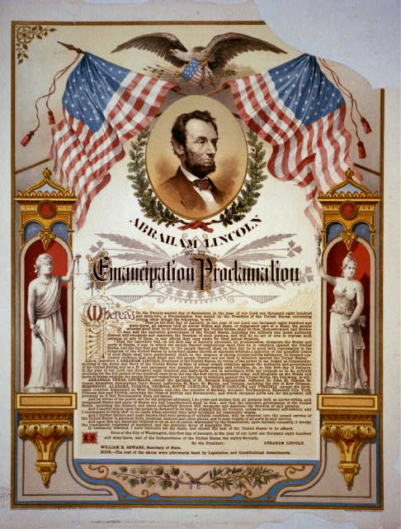
The Emancipation Proclamation
Lincoln initially didn’t intend to abolish slavery
He came to see political and military advantages in emancipating slaves
Proclamation issued after Battle of Antietam
It only freed slaves in the rebel states
Notes:
Bullet #1 Before his election as president, Abraham Lincoln did not support the total and immediate abolition of slavery. Instead, he believed that slavery should be accepted in the states and territories where it already existed, but it should not be allowed to spread into new territories acquired by the United States. He held this view even after the start of the Civil War, when he said, “My paramount object in this struggle is to save the Union, and is not either to save or destroy slavery.”
Bullet #2 By 1862, however, Lincoln had come to believe that the goal of simply saving the Union wasn’t enough to motivate many Americans. He needed to keep up morale in the North, and he felt that one way in which he could do that was by issuing an order freeing the slaves. In addition to political concerns, Lincoln also saw a military advantage emancipation could provide the North. In the South, slaves did most of the work, freeing white Confederates to fight in the war. Emancipation could possibly inspire slaves to leave and thus undermine the economy of the South. Also, it appeared more and more likely that the British might enter the war on the side of the Confederacy in order to maintain cotton supplies. If Lincoln announced the emancipation of slaves, the British, who had recently outlawed slavery in the British Empire, might be less likely to side with a nation that supported slavery. Emancipation could therefore potentially achieve the following: increasing unity in the North, creating disorganization in the South, and keeping Britain out of the war.
Bullet #3 Lincoln knew that he needed the Union army to achieve a significant victory before he could issue the Emancipation Proclamation; otherwise, the announcement might come off as an act of desperation. The bloody battle at Antietam was by no means a clear-cut victory for the North, but Lincoln decided that it was enough of a win to allow him to issue the proclamation. The document stated that Lincoln would free the slaves of any state still in rebellion as of January 1, 1863. He didn’t free all the slaves because he needed to keep the support of “border states” such as Missouri, Delaware, Kentucky, and Maryland, all of which allowed slavery but weren’t part of the Confederacy. While many saw the Emancipation Proclamation as a watershed event, it wasn’t until the ratification of the Thirteenth Amendment in 1865 that all the slaves in the United States became free.

Slide 34
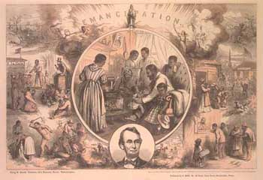
Post-Civil War Amendments
13th (1865): Ended slavery
Black codes/Civil Rights Act of 1866
14th (1868): Defined citizenship; “equal protection of the laws”
Poster celebrating the 13th Amendment
Notes:
Bullet #1 Three amendments to the Constitution were designed to put an end to the physical and political subjugation of African Americans in the U.S. Approved by Congress and ratified by the states (except for those still in the Confederacy) near the end of the Civil War in 1865, the 13th Amendment states: “Neither slavery nor involuntary servitude, except as a punishment for crime whereof the party shall have been duly convicted, shall exist within the United States, or anyplace subject to their jurisdiction.” This amendment outlawed slavery.
Bullet #2 After the war, President Andrew Johnson wanted to restore the Southern states to the Union as soon as possible. He favored a plan that would allow state governments to quickly get up and running again; accomplishing this goal, however, meant that ex-Confederates would have to play a key part in the new state governments, since they were often the only people in the state who had the appropriate experience and expertise. Johnson ended up pardoning many of these ex-Confederates, and they soon regained control of the state governments and began to enact laws that became known as “black codes.” Allegedly intended to help blacks make the transition from slavery to freedom, the laws instead placed burdensome restrictions on African Americans through measures such as curfews, vagrancy laws, land restrictions, labor contracts, and more. Republicans in Congress responded by passing the Civil Rights Act of 1866, which outlawed the black codes. Johnson vetoed the Act, but Congress overrode his veto.
Bullet #3 Even though they had managed to enact the Civil Rights Act, Congress wanted to ensure that it would survive any judicial challenges as well. Republicans, led by Charles Sumner and Thaddeus Stevens, thus drafted the 14th Amendment; section one of the amendment stated that “All persons born or naturalized in the United States, and subject to the jurisdiction thereof, are citizens of the United States and of the State wherein they reside. No State shall make or enforce any law which shall abridge the privileges or immunities of citizens of the United States; nor shall any State deprive any person of life, liberty, or property, without due process of law; nor deny to any person within its jurisdiction the equal protection of the laws.” Ratified in 1866, the amendment not only made the black codes unconstitutional, but it also overturned the Dred Scott decision and, for the first time in U.S. history, defined the meaning of citizenship.

Slide 35
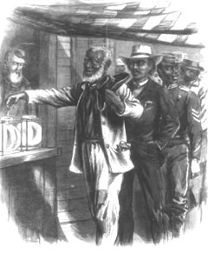
Post-Civil War Amendments (continued)
15th Amendment (1870): Gave blacks the right to vote
Notes:
While the 13th Amendment abolished slavery and the 14th Amendment gave freedmen “equal protection of the laws,” the 15th Amendment focused on guaranteeing black males the right to vote. Ratified in 1870, the amendment stated: “The right of citizens of the United States to vote shall not be denied or abridged by the United States or by any State on account of race, color, or previous condition of servitude.” While the amendment represented an important step forward for African Americans, Southern whites searched for other methods to keep blacks from voting, such as literacy tests, “grandfather clauses,” and “poll taxes.” In addition, many women felt somewhat slighted by the passage of the Fifteenth Amendment. While many women had helped lead the abolition movement, they had also hoped that freeing slaves and giving blacks equality would lead to granting women the right to vote. They would have to wait until the passage of the Nineteenth Amendment 50 years later to gain the right of suffrage.

Slide 36
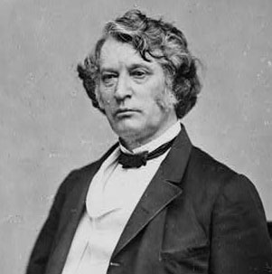
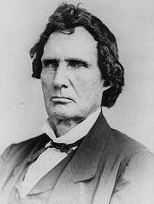
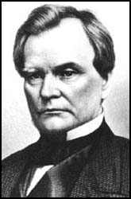
Reconstruction
Lincoln’s “Ten Percent Plan”
Radical Republicans • Wade-Davis Bill
“Radicals” Charles Sumner, Thaddeus Stevens, and Benjamin Wade
Notes:
Bullet #1 In 1864, President Lincoln began to consider what a policy of “reconstruction”—returning the former Confederate states to the Union—would involve. He felt that the best way to deal with returning the Confederate states to the Union was to provide lenient terms, to “let ‘em up easy”, as he put it. In his view, the Civil War was a revolt by individuals, not by states. He believed the states had never actually left the Union. He also believed that responsibility for reconstruction should fall to the executive branch, and the president should use his Constitutional power of the pardon to restore the Union. In his “Proclamation of Amnesty and Reconstruction,” which became known as the “Ten Percent Plan,” the government would recognize a former Confederate state once ten percent of its citizens who had voted in the 1860 presidential election signed a loyalty oath swearing that they would never again take up arms against the United States. Only the highest Confederate officials and any suspected of war crimes would not receive pardons.
Bullet #2 While Lincoln favored “executive reconstruction” as well as lenient terms for the former Confederate states, a group of Congressional Republicans known as “Radicals” supported much more stringent terms for these states to return to the Union. The Radicals felt that since the South had left the Union, those states had extremely limited political rights; furthermore, since the South had lost the war, Radicals viewed the former Confederate states as “captured provinces.” The Radicals also suggested that only the legislative branch could effectively return the Southern states to the Union. In the summer of 1864, the Radicals engineered the passage of the Wade-Davis Bill, which outlined a much harsher plan for reconstruction. The bill only allowed a state to reenter after a majority of the number of voters who voted in the 1860 election signed the loyalty oath—a far greater number than the ten percent Lincoln had wanted. The Wade-Davis Bill also excluded anyone who voluntarily took up arms against the Union from receiving a pardon. In essence, the bill showed that the Radicals were not that eager for the former Confederate states to rejoin the Union; instead, it seemed that the bill really aimed to punish the South. Lincoln decided to exercise a “pocket veto” for the bill, and failed to either sign or veto it before the end of the Congressional term. This angered the Radicals, and the possibility of a major battle between the White House and Congress became more and more likely. Lincoln was assassinated in April 1865, and Andrew Johnson became president.

Slide 37
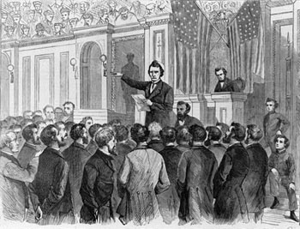
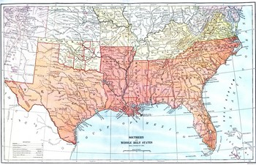
Reconstruction (continued)
Johnson’s plan
Reconstruction Act of 1867 • impeachment
Thaddeus Stevens closing the debate on Johnson’s impeachment
Notes:
Bullet #1 Johnson, a Democrat from Tennessee, opposed slavery and supported the 13th Amendment. His reconstruction plan made ratification of the amendment a key requirement for Southern states to reenter the Union. He did not share the Republicans’ desire to deny pardons to ex-Confederates. Johnson wanted the Southern states back in the Union as soon as possible, and for that to happen, many ex-Confederates needed to be pardoned. Johnson also believed that freedmen did not deserve equal rights or the right to vote; consequently, he had no problem when the ex-Confederates he pardoned started enacting black codes in Southern states. This angered the Radicals; they became further incensed when Johnson gave speeches opposing ratification of the 14th Amendment.
Bullet #2 In 1867, Republicans pushed the Reconstruction Act through Congress. The act divided the South into five military districts, each of which would be governed by a Northern general; it ordered Southern states to hold new elections and write new state constitutions; it required the states to allow African American men to vote; it temporarily took away the right to vote from ex-Confederates; it mandated that the states ensure equal rights for all their citizens; and it required the states to ratify the 14th Amendment. The act also inflamed the conflict between Johnson and the Radicals; relations between the president and congressional Republicans quickly went downhill and ultimately resulted in the House of Representatives drafted articles of impeachment against Johnson. Meanwhile, the Union army began to register freedmen to vote in the South, and in 1870, several African Americans were elected to state legislatures. Radical Reconstruction had a dramatic impact on the South, and it stayed in place until the disputed presidential election and subsequent Southern “Redemption” of 1876.

Slide 38
The Ku Klux Klan
Former Confederate general Nathan Bedford Forrest, the first Grand Wizard of the KKK
Originally organized as a social club for Confederate veterans
Top goal became assuring white supremacy
Violent tactics
Enforcement Acts of 1870 and 1871 • decline of the KKK
Revivals in the 1920s, 1950s and 1960s
Notes:
Bullets #1–3 The Ku Klux Klan actually began in Tennessee in 1866 as a fraternal organization for Confederate veterans; however, it soon evolved into a violent organization that used intimidation, murder, arson, and other tactics to keep freedmen from exercising their political rights. The KKK murdered thousands of African Americans who wished to vote, hold office, or campaign for equality; the Klan also set fire to blacks’ homes, schools, churches, and crops. The KKK also targeted Southern whites who sympathized with the cause of the blacks or who tried to assist blacks by teaching them to read and write, renting land to them at reasonable prices, or buying their crops. Klan members wore white hoods and robes in order to kept their identities hidden; thus, blacks and those who aided them were never totally sure who was (or who wasn’t) a member of the KKK.
Bullet #4 In many Southern states the work of the Klan had its intended effect: black voter turnout in state and national elections dropped dramatically. The federal government responded by passing two Enforcement Acts specifically designed to curb Klan activity. The acts made it a criminal offense to try to obstruct blacks from voting, receiving equal protection under the law, or serving on juries. On occasion, President Grant sent federal troops to Southern states to guarantee enforcement of the laws. These actions greatly weakened the KKK, and by 1872, the Klan had lost a great deal of its power.
Bullet #5 In the early part of the 20th century, a former preacher named William J. Simmons revived the KKK. This new incarnation of the Klan operated in a more sophisticated manner, using modern fundraising techniques and public relations tactics to gain members and create a better public image. By 1924, the new KKK had managed to spread beyond the South, and some have estimated that the organization boasted over four million members by this time. The Klan also shifted its focus, placing more of an emphasis on “defending white culture” against immigrants, Catholics, and Jews, and other groups they viewed as “non-Nativist.” The KKK declined once again when a prominent Indiana leader was convicted of rape and murder. In the 1950s and 1960s, many small groups labeling themselves as KKK briefly appeared, primarily to oppose the civil rights movement. None of these groups, however, were able to rally public support and wield significant political power like the first two incarnations of the Klan had.

Slide 39
Sharecropping
Many freedmen couldn’t afford their own land
Sharecropping: landholders divided their property into plots and provided farmers on each plot with seed and farm implements to work the land
The sharecropper used a portion of his crop to pay the landholder
Landholders often abused the system
Notes:
Bullet #1 Though freed from slavery after the Civil War, many African Americans in the South could not purchase land for farming, which meant that they couldn’t grow crops to sell or to feed their families. A system called “sharecropping” arose in response to this problem.
Bullets #2–4 In sharecropping, landowners divided their property into plots and gave each sharecropper the seeds and tools needed to grow a small crop. The sharecropper usually paid the planter by giving him a certain percentage of the crops he grew. In theory, sharecropping seemed equitable; in practice, however, it rarely worked out this way. Sharecroppers often fell behind in their payments because of low prices on the open market for their crops. Many landowners would then charge substantial fines or apply high interest rates to the balance owed. The net result was that many sharecroppers found it more and more difficult to gain financial independence. Stuck in a vicious cycle of increasing debt, many freedmen found that sharecropping was essentially a return to slavery.

Slide 40
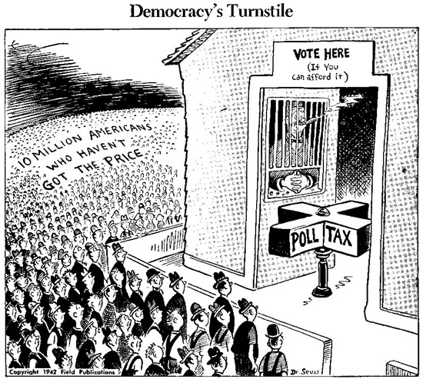
Jim Crow Laws
Named after a popular minstrel show song
Laws that limited black voting
Laws that instituted racial segregation
Notes:
Bullet #1 As the Reconstruction era continued, Southern states prevented African Americans from attaining full equality by devising legal ways to bypass the Constitution and federal officials. Collectively, the measures passed became known as “Jim Crow laws,” named after a popular minstrel show routine.
Bullet #2 While the Fifteenth Amendment had given African Americans the right to vote, its language only listed three conditions which could NOT be used to deny the vote to someone: “race, color, or previous condition of servitude.” Southern whites soon came up with alternative ways to legally keep blacks from exercising their right to vote. Among these were literacy tests, poll taxes, “grandfather clauses,” and “white primaries.” Many states instituted “literacy tests” as a requirement for voting. Frequently these tests involved reading excerpts from legal documents or the Constitution, followed by comprehensive questions about those documents. Even if a black applicant for registration could “correctly” answer a question, the directions stated that the questions had to be answered to the satisfaction of the person administering the test, which made it even more difficult to pass. With a poll tax, voters had to pay a certain sum when they registered. Ostensibly, this tax would help local governments pay the cost of elections; in actuality, since the African American population in the South was mostly poor, the poll tax ended up preventing blacks from exercising their right to vote. Though the South had its share of poor whites as well, rich whites would often pay their poll taxes or find some way to grant them exemptions. “Grandfather clauses” stated that only people eligible to vote were those whose grandfathers had been eligible to vote on January 1st, 1867—before the 15th Amendment gave blacks the right to vote. In “white primaries,” southern Democrats asserted that their primary election was a “private” election by invite only. Needless to say, African American voters did not receive and invites.
Bullet #3 Jim Crow laws also created a system of institutionalized segregation. Throughout the South, whites and blacks had separate schools, hospitals, public waiting rooms and restrooms, seats on buses and trains, sections and theaters, and many more. Usually, the facilities designed for blacks were far inferior to those used by whites.

Slide 41
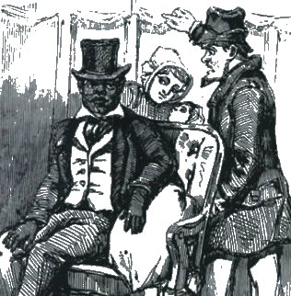
Plessy v. Ferguson
Involved a Louisiana African American man arrested for refusing to leave a “whites only” train car
Supreme Court rules against Plessy
“Separate but equal”
Notes:
Bullet #1 Although segregation in the South clearly favored whites, it was not until 1896 that any legal challenge to segregation reached the Supreme Court. The case arose when Homer Plessy, a person of mixed race, took a seat in the “Whites Only” section of a Louisiana train and refused to move when ordered. He was arrested and convicted for violating Louisiana’s segregation law. In the lower courts, Plessy lost, so he appealed to the Supreme Court.
Bullet #2 Although the 14th Amendment guaranteed equal protection under the law, by the end of the 19th century, the Supreme Court had consistently narrowed the idea of the intent of the amendment, consistently ruling that it dealt only with abuses by the federal government, and that the private citizens were exempted from the terms of the amendment. In Plessy, the Supreme Court again had to rule on the validity and scope of the amendment. The Court ruled against Plessy; Justice Henry B. Brown, writing the opinion for the 8-1 majority, stated that, “Laws permitting, and even requiring, their [the races’] separation in places where they are to be brought into contact do not necessarily imply the inferiority of either race to the other.” In essence, Justice Brown stated that as long as the facilities provided were “equal,” it was legal to segregate by race.
Bullet #3 The Plessy decision provided a legal basis for segregation, and the phrase “separate but equal” became ingrained in the public consciousness. “Separate but equal” remained the law for nearly half a century to overturn, until the Court ruled in the 1955 Brown v. Board of Education decision that segregation was inherently unequal.

