Slide 1
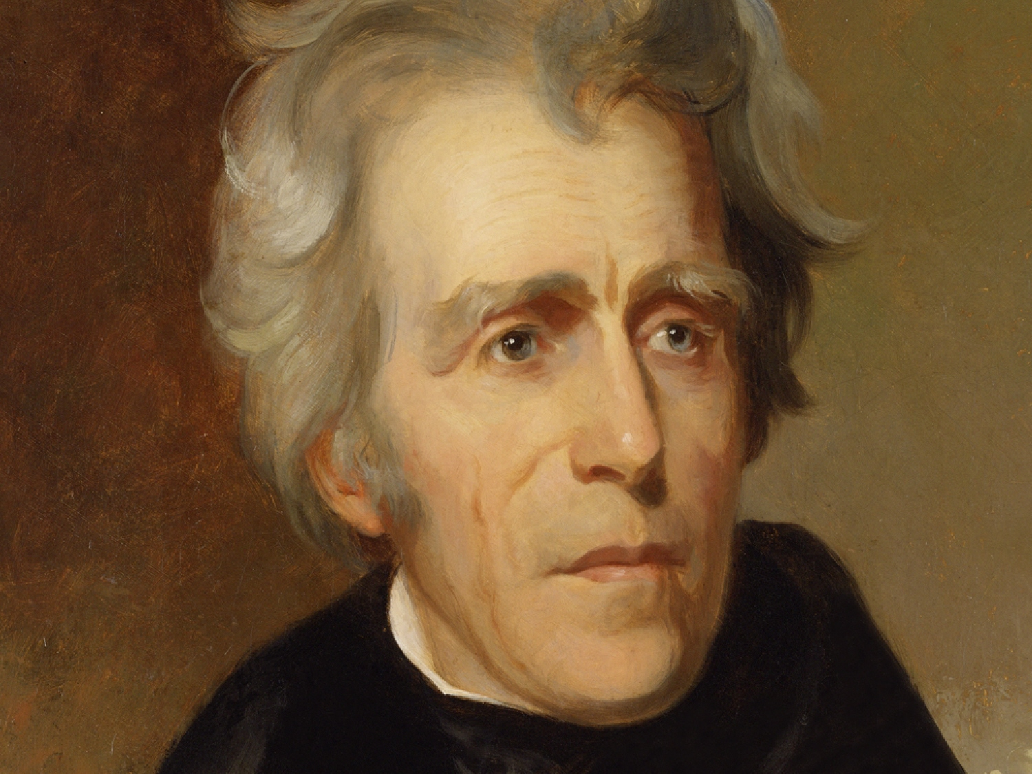
Andrew Jackson
APUSH

Slide 2
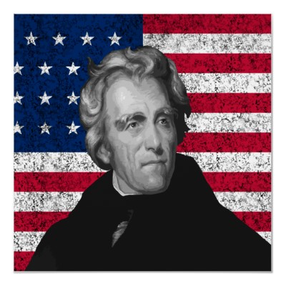
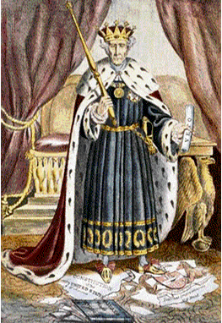
Essential Question:
Was Andrew Jackson
A protector of the Common Man?
“King Andrew”?
OR

Slide 3
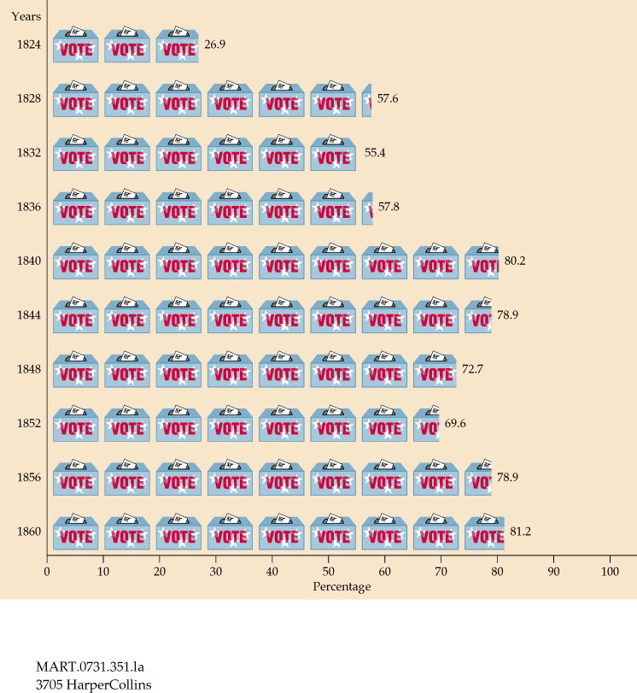
General Democratic Trends of the 19th Century
Increased white male suffrage
Increased Political Party influence
Popular Campaigning
High Voter Turnout

Slide 4
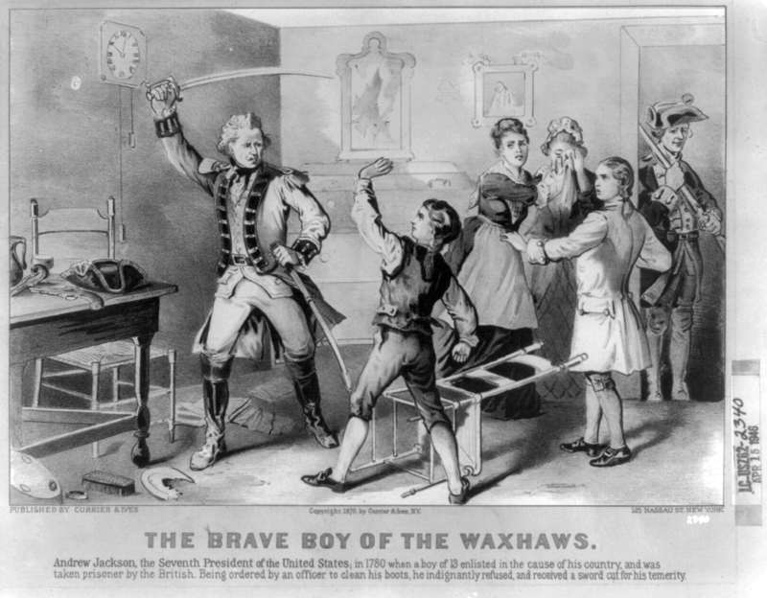
Jackson’s Early Life
Family
- Born somewhere along what is now NC and SC border
- Father died 2 mos. before Jackson born
Revolutionary War Service
- War started when Jackson 13:Served as courier
- Refused to shine a British officers boots,
Was slashed by sword and taken prisoner
- Jackson and brother caught smallpox, brother
died
- Mother served as a nurse, and died of Cholera

Slide 5
Early Governmental Service
Even with little education, became a country lawyer in Tennessee
Elected as delegate to TN Constitutional Convention- 1796
Became the first US Representative from TN
Later elected Senator, but resigned after less than a year
Appointed Judge of TN Supreme Court- served until 1804

Slide 6
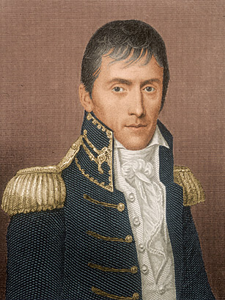
Early Military Career
Appointed commander of TN Militia 1801
War of 1812- Victorious General at the Battle of New Orleans
Seminole War (Leading to Adams-Onis)

Slide 7
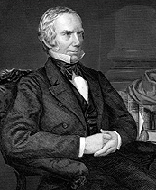
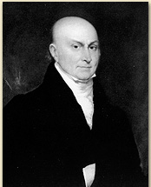
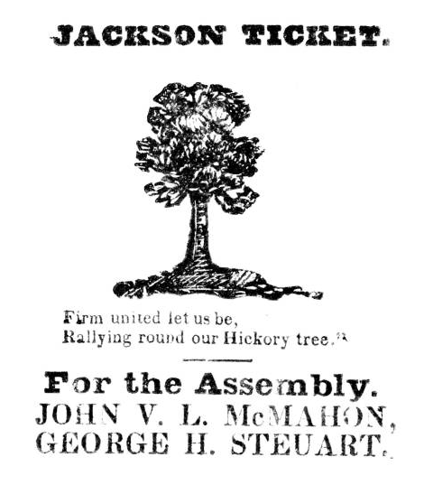
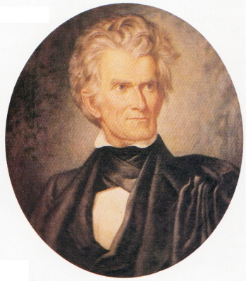
Election of 1824
A Corrupt Bargain?

Slide 8
Election of 1828 Major Issues
The Tariff of Abominations
Tariff Battles
Tariff of 1816
Taxed Imports of cheap textiles
Tariff of 1824
Taxed Iron Goods and more expensive woolen and cotton imports
Tariff of 1828
Taxed imported raw materials (wool & hemp)
Supported by Jacksonians
South Against (didn’t need and caused American textiles to be more expensive)

Slide 9
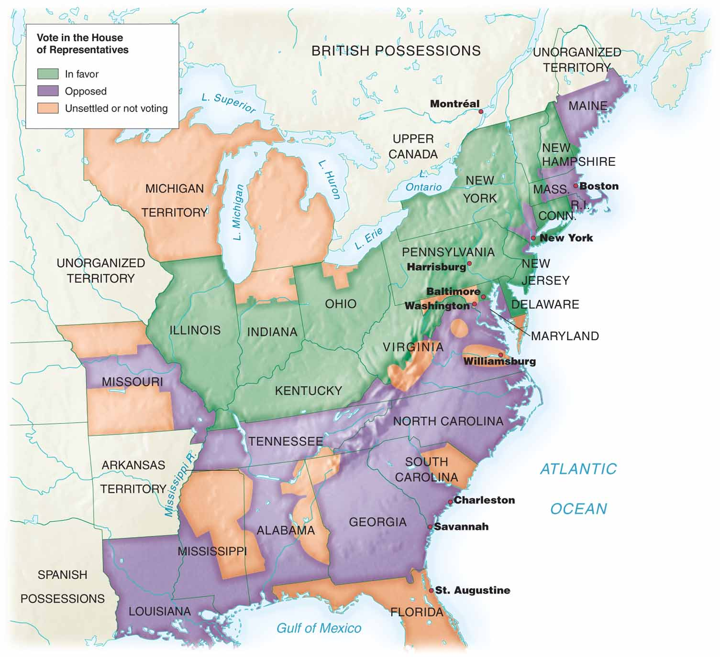
Votes in House for Tariff of Abominations

Slide 10
Election of 1828 Major Issues
Land and Indian Policies
Actions by JQ Adams
Land Policies Angered Westerners
Attempted to curb speculation of public lands
Supported land rights of Natives over white settlers
1825- Govt. negotiated treaty with Creek Indians to cede land rights to GA
Adams supported natives
Congress sided with Governor of Georgia

Slide 11
Election of 1828
The Birth of the Democratic Party
Jackson angered that the Dem. Republicans had moved away from Jefferson’s message/intentions
Jackson drew together old Jeffersonian Coalition
Northern farmers and artisans, Southern Slave Owners, Small Farmers
Created the Democratic Party

Slide 12
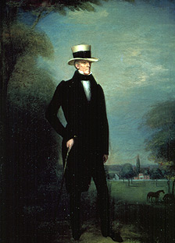
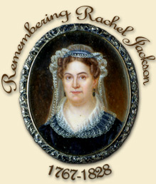
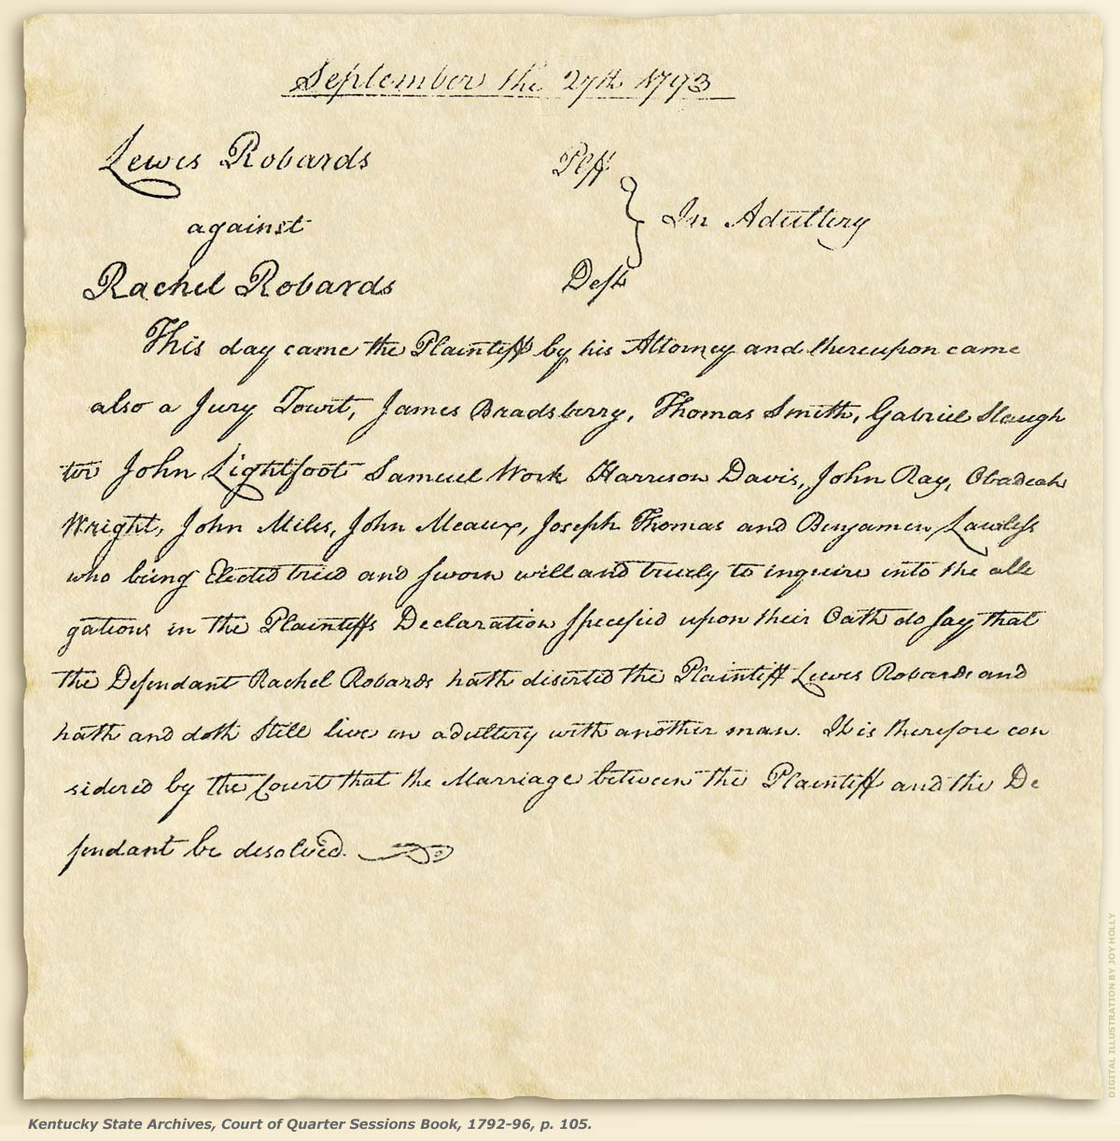
Rachel Jackson

