Slide 1
Slavery in Antebellum America
APUSH (Pageant Chapter 16)

Slide 2
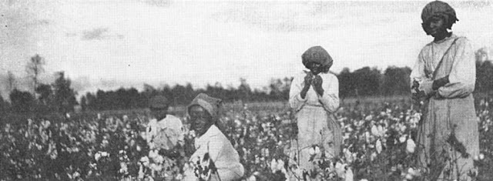
Cotton is King!
Cotton Gin- Revives Slavery
South and Others Profit From Cotton
Cotton ½ of all American Exports after 1840
Produced more than ½ of world supply
75% of British cotton
Quick profits from Cotton led to more fields/slaves

Slide 3
Slave Cotton Production
1820
Slave Cotton Production
1860

Slide 4
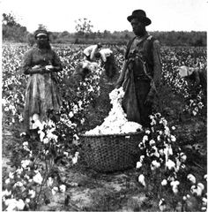
Cotton is King! (cont.)
Dangerous (unstable) one-crop economy
Over-speculation of land and slaves
Small farmers had to sell land to large plantations
Moved west for fresh land

Slide 5
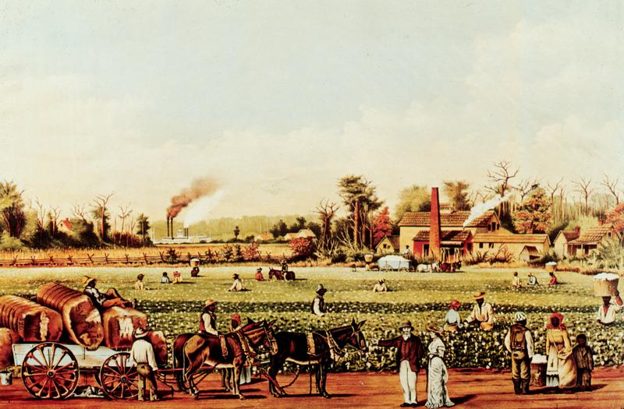
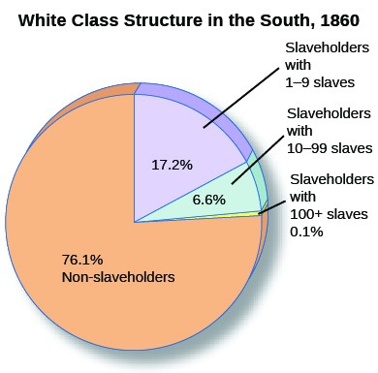
Planter “Aristocracy”
By 1850: ¼ of Southern whites owned slaves
1,733 families owned 100+ slaves
89,732 families owned 10-99
255,288 owned 10 or less
¾ of whites- owned 0 slaves
Back Country/Mountain Valleys
Subsistance Farming
“poor white trash”, “hillbillies”
Poor whites often defended slavery
Hope of social mobility/pure racism

Slide 6
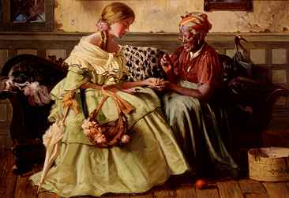
Planter “Aristocracy”
Southern Oligarchy
Government by the few
Plantation women
Commanded sizeable household staff

Slide 7
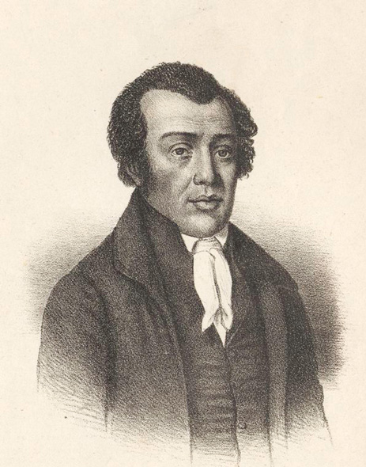
Free Blacks
250,000 Southern Free Blacks
Bought Freedom
Emancipated after Revolution
Some owned slaves
Eternally vulnerable
250,000 Northern Free Blacks
Unpopular- Job Competition

Slide 8
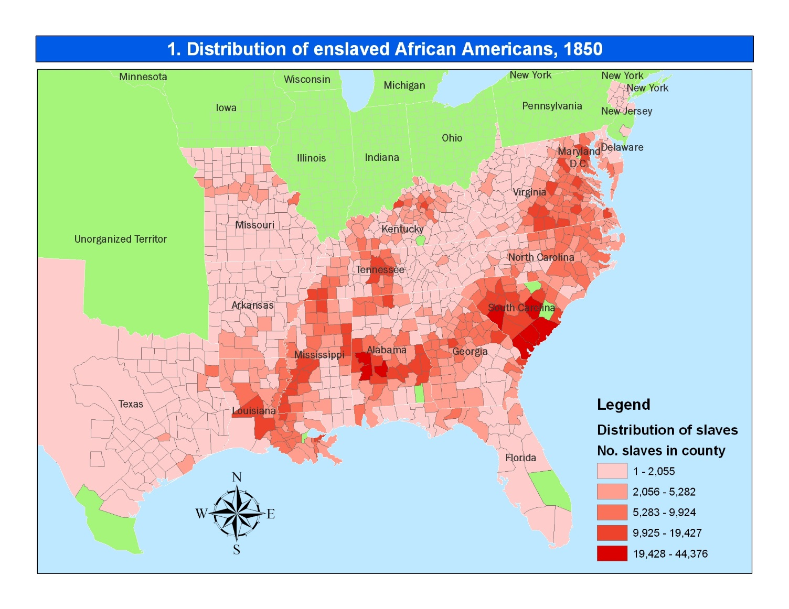
Slave Life- The “Peculiar Institution”
By 1860- 4 million slaves
International Slave Trade illegal
Smuggling- If caught, acquittal almost guaranteed
Growth through natural reproduction
Deep South- “Black Belt”
Majority or near majority of inhabitants blacks
SC, FL, MS, AL, LA
Sizeable Mulatto Population

Slide 9
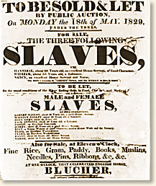
Slave Life- Continued
Slave Auctions
Most revolting aspect of slavery
Separation of families- Psychologically damaging
Harriet Beecher Stowe’s Uncle Tom’s Cabin

Slide 10
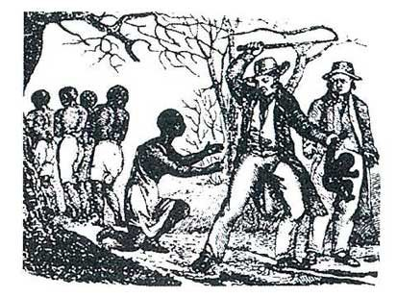
Slave Life- Continued
Conditions varied, but all:
Hard work, ignorance & oppression
Floggings
“difficult” slaves sent to breakers
Family life persisted
Marriages (not recognized by law)
Large plantations provided better
chance of staying together
Distinct African American slave culture
Mix of Christianity & African culture
I.E. Responsorial preaching

Slide 11
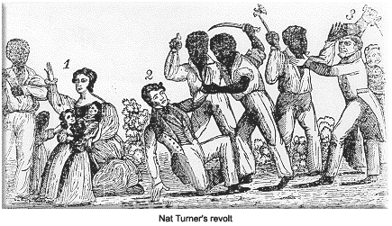
Slave Rebellions
Rebellions led to Southern Paranoia
1800 in VA- Revolt led by Gabriel Prosser
Betrayed by informers- leaders hung
1822 in SC- Denmark Vessey (Free Black)
Betrayed by informers- 30 hung
1832- Nat Turner’s Rebellion
Uprising- Killed 60 Virginians- Mostly women and Children
Leaders Killed
Slaves began “Quiet” Rebellion
- Sabotage of machinery, slow down work, stealing goods

Slide 12
Abolitionist Movements
Beginnings- Quakers During Rev War
American Colonization Society- 1817
Transported back to Africa
Liberia 1822
Second Great Awakening- spread cause
Weld- “Burned over distric”
Arthur and Lewis Tappan- Wealthy NY Merchants
Lyman Beecher- Lane Theological Seminary (Ohio)
Father of Harriet Beecher Stowe, Catharine Beecher

Slide 13
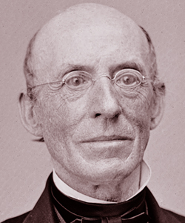
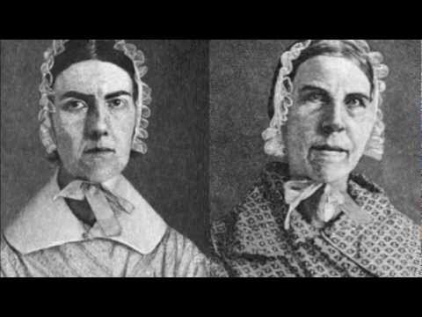
Radical Abolitionists
William Lloyd Garrison
The Liberator
30 year anti-slavery newspaper, started 1831
Uncompromising- Only immediate and complete end of slavery would do
Angelina and Sarah Grimke
Worked for Garrison
Had grown up on a wealthy southern plantation
First hand knowledge of the horrors of slavery
Wendell Phillips
American Anti-Slavery Society (1833)
“Abolition’s Golden Trumpet”
Refused to wear cotton or eat sugar cane

Slide 14
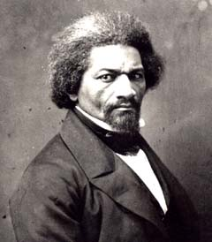
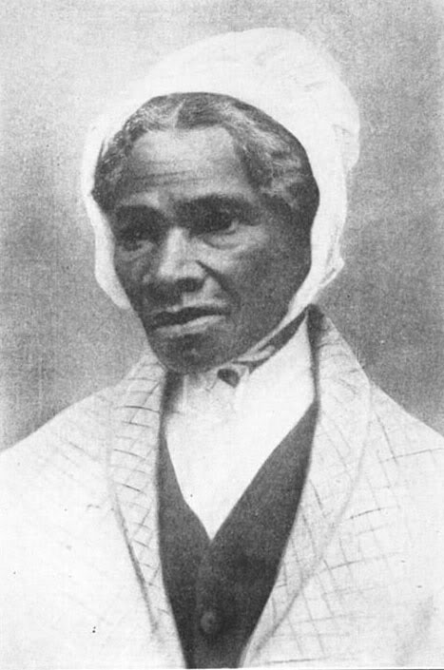
Black Abolitionists
David Walker
Appeal to the Colored Citizens of the World (1829)
Called for bloody end to white supremacy
Sojourner Truth- Freed Black Woman
Fought for emancipation and women’s rights
“Ain’t I a Woman Too?”
Frederick Douglass- Escaped Slave
“Narrative of the Life of Frederick Douglass”
Wonderful Speaker
Backed Liberty Party and Free Soil Party
Founder of “The North Star”- abolitionist newspaper

Slide 15
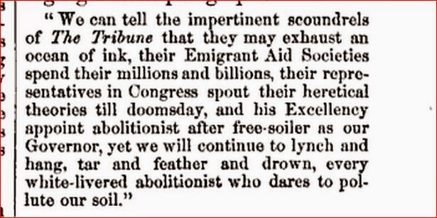
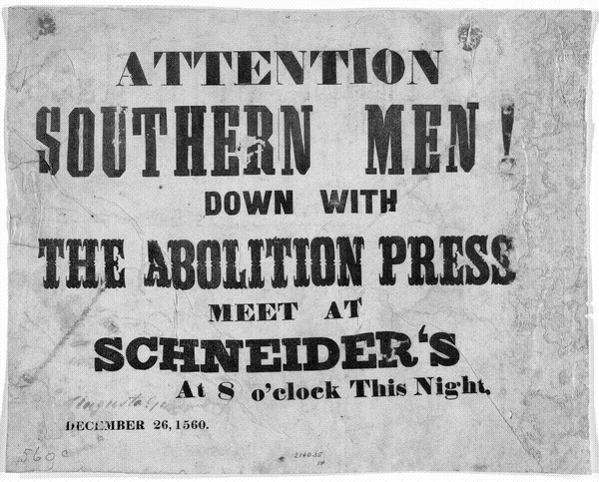
Southern Reaction to Abolition
1830’s- tightened slave codes
Followed Nat Turner’s Rebellion
Nullification Crisis- 1832
Paranoia- no tolerance for abolitionists
1836- “Gag Resolution”
Anti-slavery appeals tabled without debate in Congress
JQ Adams fought to repeal for 8 years
1835- Post Office
Allowed to burn abolitionist literature in South

Slide 16
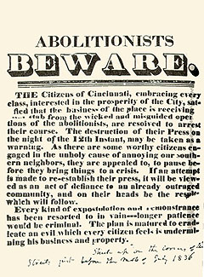
Northern Reaction to Abolition
Love of Constitution
Slavery a lasting bargain
Disliked talk of secession
Economic Stake
Shipping and Textiles
Southern planters owed $300 to northerners
Hostility toward radical abolitionists
Elijah P. Lovejoy killed in mob in Boston (1837)
Most just opposed extending slavery to the west
“Free Soilers”

